Slide 1



Memory Systems Fundamentals, Recent Research, Challenges, Opportunities Lecture 2a: Memory Scaling: Reliability & Security
Prof. Onur Mutlu
omutlu@gmail.com
https://people.inf.ethz.ch/omutlu
8 October 2018
Technion Fast Course 2018

Slide 2
Four Key Directions
Fundamentally Secure/Reliable/Safe Architectures
Fundamentally Energy-Efficient Architectures
Memory-centric (Data-centric) Architectures
Fundamentally Low-Latency Architectures
Architectures for Genomics, Medicine, Health

Slide 3
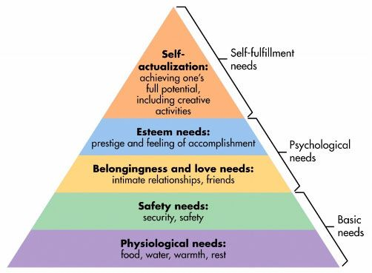

Maslow’s (Human) Hierarchy of Needs
Maslow, “A Theory of Human Motivation,”
Psychological Review, 1943.
Maslow, “A Theory of Human Motivation,”
Psychological Review, 1943.
Maslow, “Motivation and Personality,”
Book, 1954-1970.
We need to start with reliability and security…
Source: https://www.simplypsychology.org/maslow.html
Source: By User:Factoryjoe - Mazlow's Hierarchy of Needs.svg, CC BY-SA 3.0, https://commons.wikimedia.org/w/index.php?curid=7964065

Slide 4
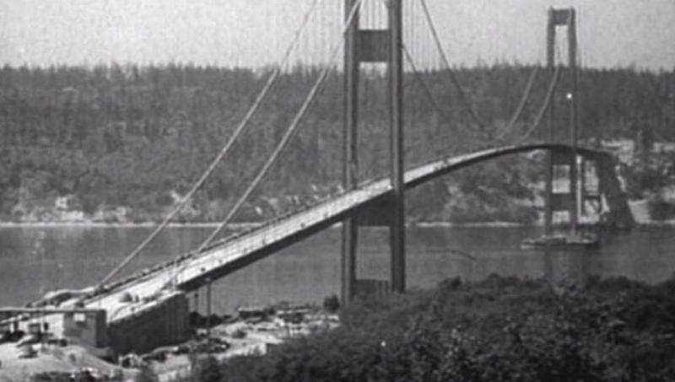
How Reliable/Secure/Safe is This Bridge?
Source: http://www.technologystudent.com/struct1/tacom1.png

Slide 5
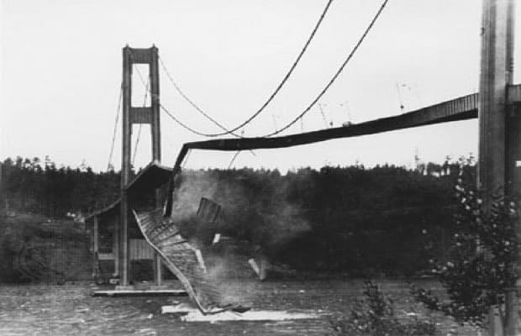
Collapse of the “Galloping Gertie”
Source: AP
http://www.wsdot.wa.gov/tnbhistory/connections/connections3.htm

Slide 6

How Secure Are These People?
Security is about preventing unforeseen consequences
Source: https://s-media-cache-ak0.pinimg.com/originals/48/09/54/4809543a9c7700246a0cf8acdae27abf.jpg

Slide 7
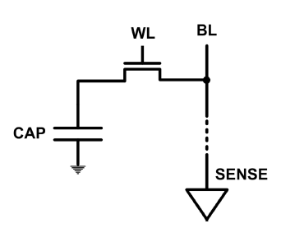
The DRAM Scaling Problem
DRAM stores charge in a capacitor (charge-based memory)
Capacitor must be large enough for reliable sensing
Access transistor should be large enough for low leakage and high retention time
Scaling beyond 40-35nm (2013) is challenging [ITRS, 2009]
DRAM capacity, cost, and energy/power hard to scale

Slide 8
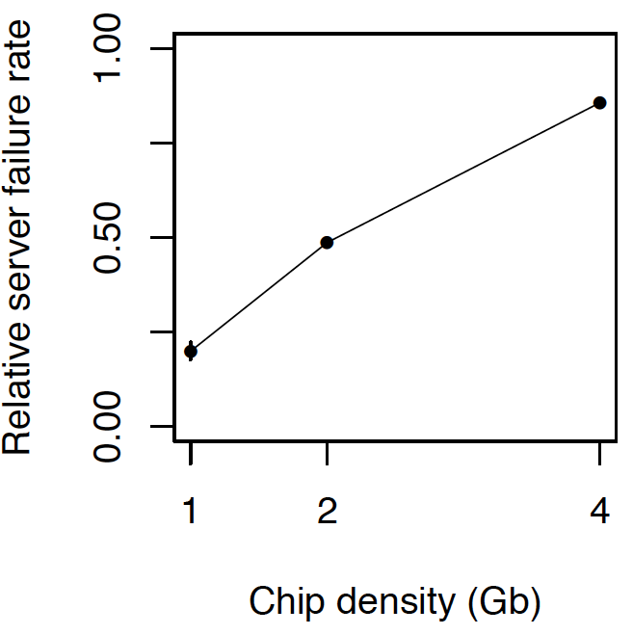
As Memory Scales, It Becomes Unreliable
Data from all of Facebook’s servers worldwide
Meza+, “Revisiting Memory Errors in Large-Scale Production Data Centers,” DSN’15.
Intuition: quadratic increase in capacity

Slide 9
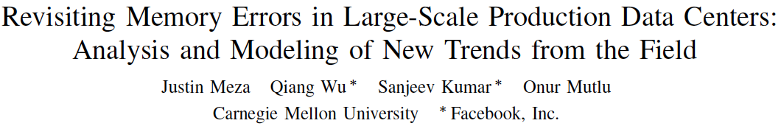
Large-Scale Failure Analysis of DRAM Chips
Analysis and modeling of memory errors found in all of Facebook’s server fleet
Justin Meza, Qiang Wu, Sanjeev Kumar, and Onur Mutlu, "Revisiting Memory Errors in Large-Scale Production Data Centers: Analysis and Modeling of New Trends from the Field" Proceedings of the 45th Annual IEEE/IFIP International Conference on Dependable Systems and Networks (DSN), Rio de Janeiro, Brazil, June 2015. [Slides (pptx) (pdf)] [DRAM Error Model]

Slide 10
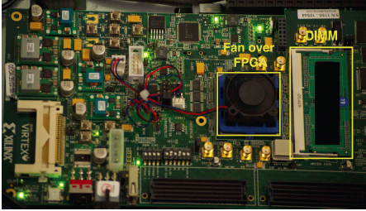
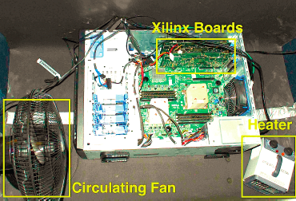
Infrastructures to Understand Such Issues
An Experimental Study of Data Retention Behavior in Modern DRAM Devices: Implications for Retention Time Profiling Mechanisms (Liu et al., ISCA 2013)
The Efficacy of Error Mitigation Techniques for DRAM Retention Failures: A Comparative Experimental Study
(Khan et al., SIGMETRICS 2014)
Flipping Bits in Memory Without Accessing Them: An Experimental Study of DRAM Disturbance Errors (Kim et al., ISCA 2014)
Adaptive-Latency DRAM: Optimizing DRAM Timing for the Common-Case (Lee et al., HPCA 2015)
AVATAR: A Variable-Retention-Time (VRT) Aware Refresh for DRAM Systems (Qureshi et al., DSN 2015)

Slide 11
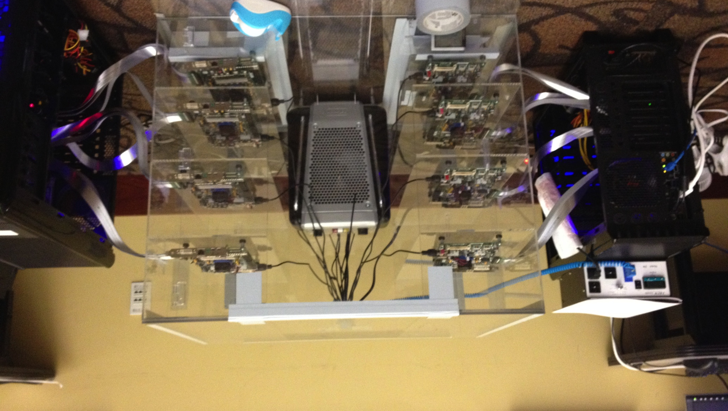
Infrastructures to Understand Such Issues
Temperature
Controller
FPGAs
Heater
FPGAs
PC
Kim+, “Flipping Bits in Memory Without Accessing Them: An Experimental Study of DRAM Disturbance Errors,” ISCA 2014.

Slide 12
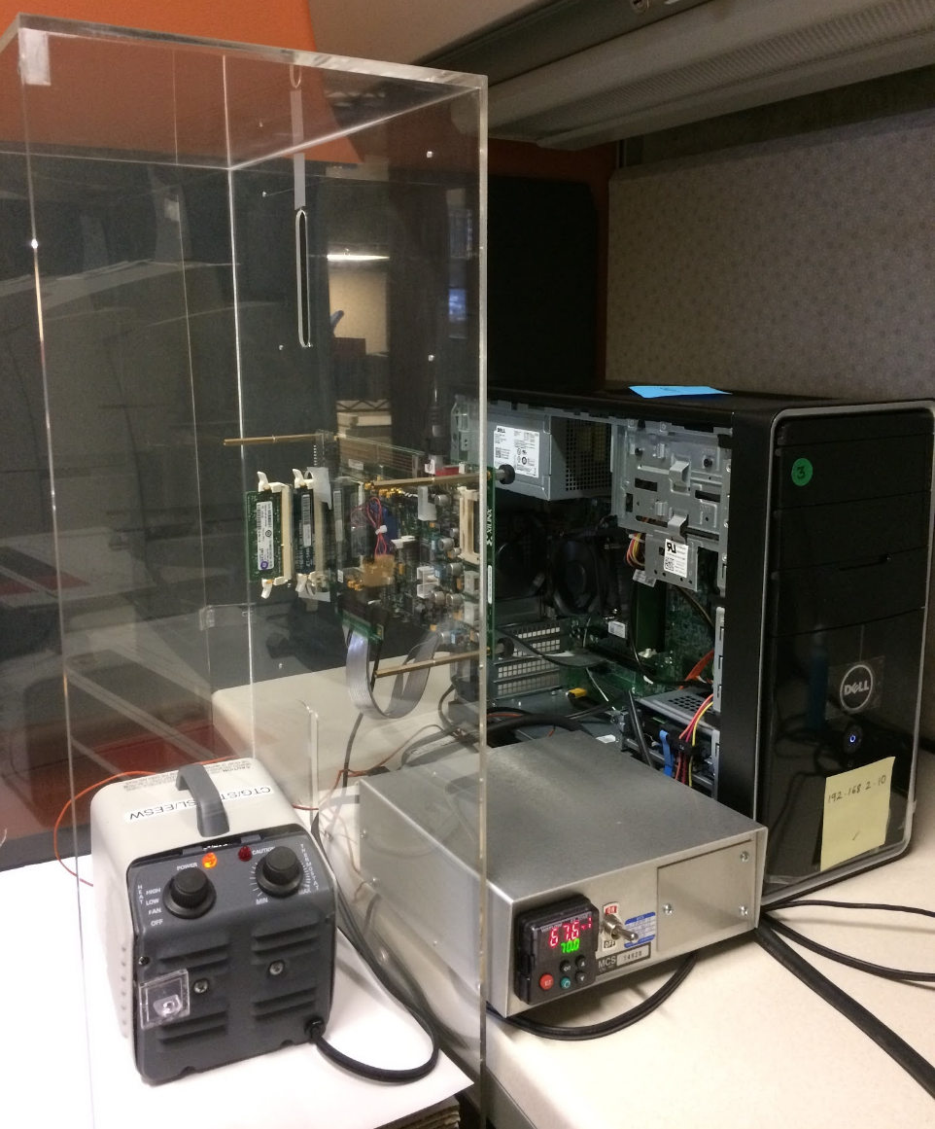
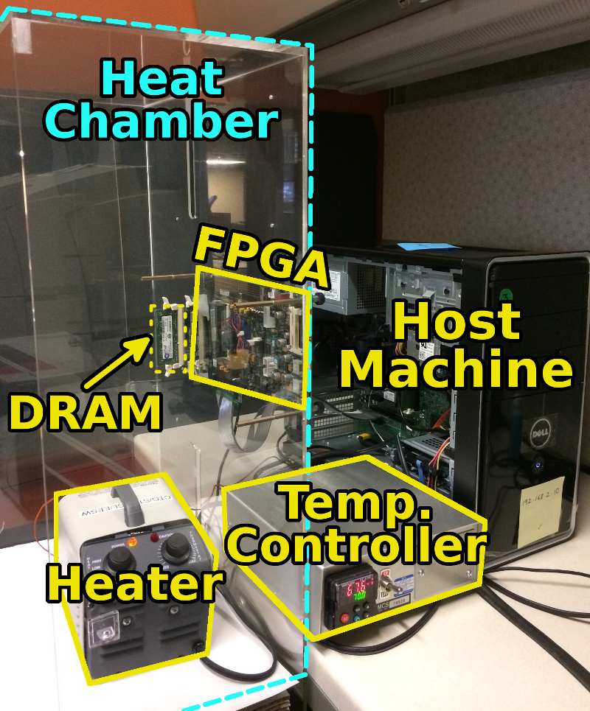
SoftMC: Open Source DRAM Infrastructure
Hasan Hassan et al., “SoftMC: A Flexible and Practical Open-Source Infrastructure for Enabling Experimental DRAM Studies,” HPCA 2017.
Flexible
Easy to Use (C++ API)
Open-source
github.com/CMU-SAFARI/SoftMC

Slide 13
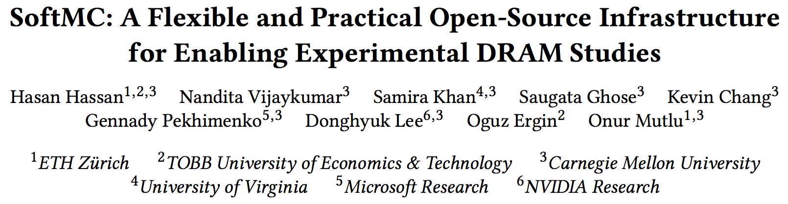
SoftMC
https://github.com/CMU-SAFARI/SoftMC

Slide 14
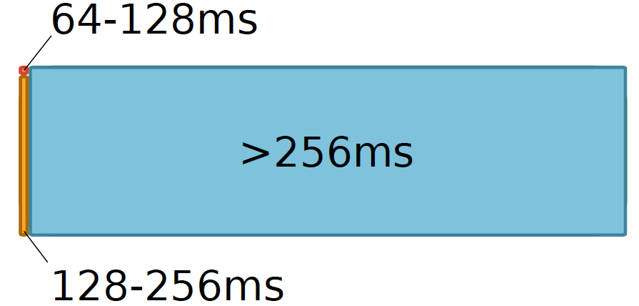
Data Retention in Memory [Liu et al., ISCA 2013]
Retention Time Profile of DRAM looks like this:
Location dependent
Stored value pattern dependent
Time dependent

Slide 15
A Curious Discovery [Kim et al., ISCA 2014]
One can
predictably induce errors
in most DRAM memory chips

Slide 16
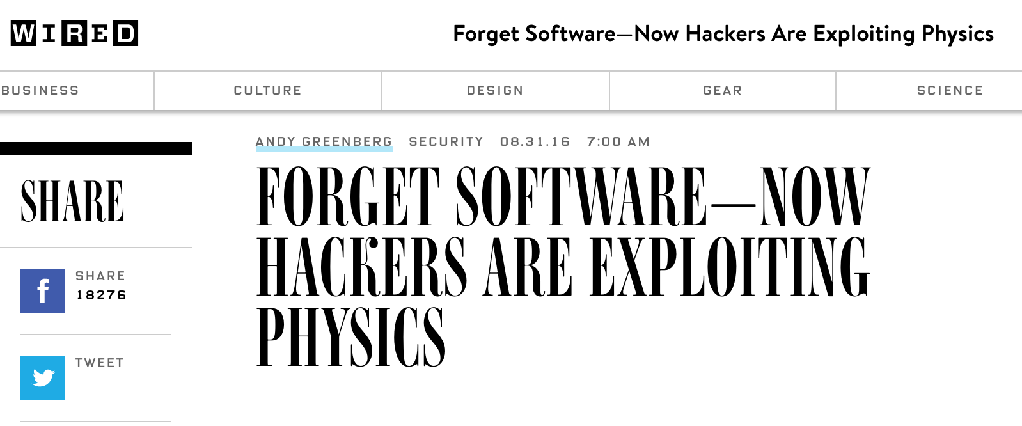
DRAM RowHammer
A simple hardware failure mechanism
can create a widespread
system security vulnerability

Slide 17
Modern DRAM is Prone to Disturbance Errors
Row of Cells
Wordline
Row
Victim Row
Row
Hammered Row
V_{LOW}
Opened
V_{HIGH}
Closed
Row
Victim Row
Row
Repeatedly reading a row enough times (before memory gets refreshed) induces disturbance errors in adjacent rows in most real DRAM chips you can buy today
Flipping Bits in Memory Without Accessing Them: An Experimental Study of DRAM Disturbance Errors, (Kim et al., ISCA 2014)

Slide 18
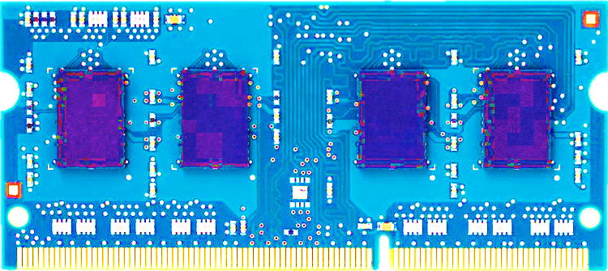
Most DRAM Modules Are Vulnerable
A company
B company
C company
86%
(37/43)
83%
(45/54)
88%
(28/32)
Up to
1.0×10⁷ errors
Up to
2.7×10⁶ errors
Up to
3.3×10⁵ errors
Flipping Bits in Memory Without Accessing Them: An Experimental Study of DRAM Disturbance Errors, (Kim et al., ISCA 2014)

Slide 19
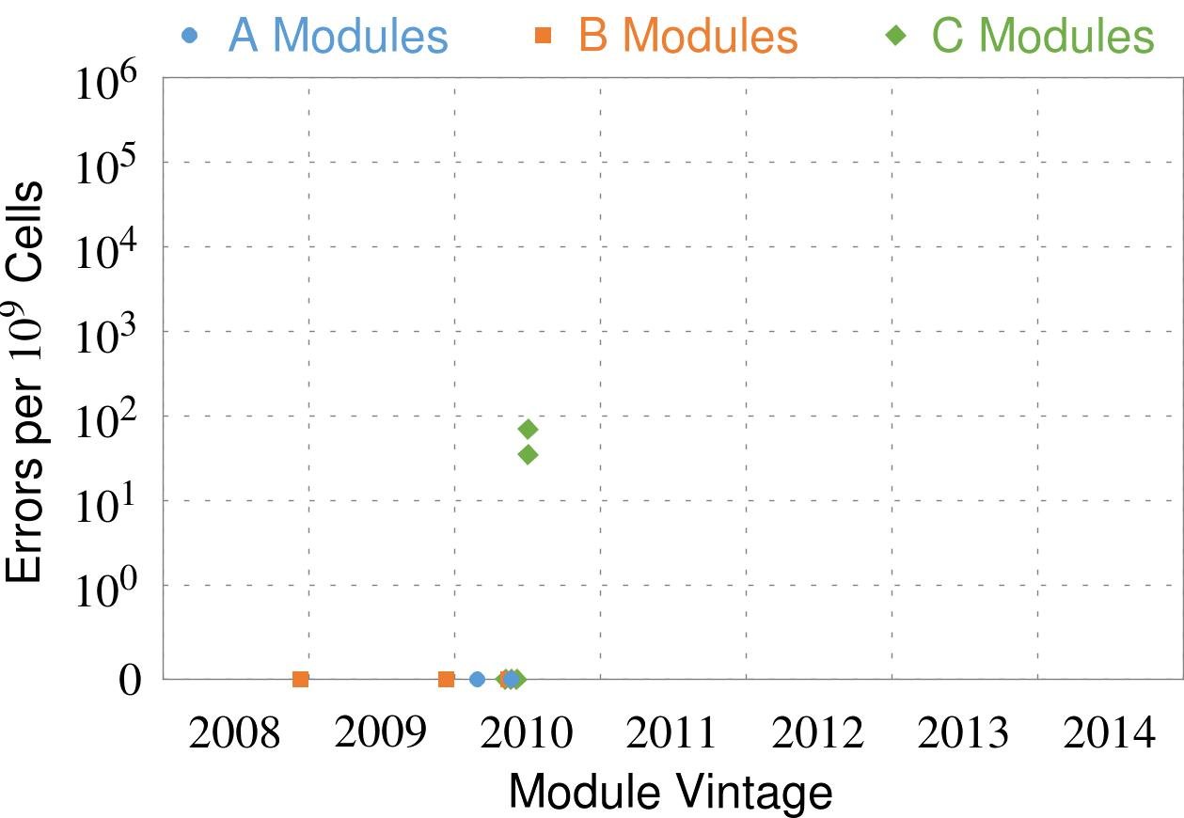
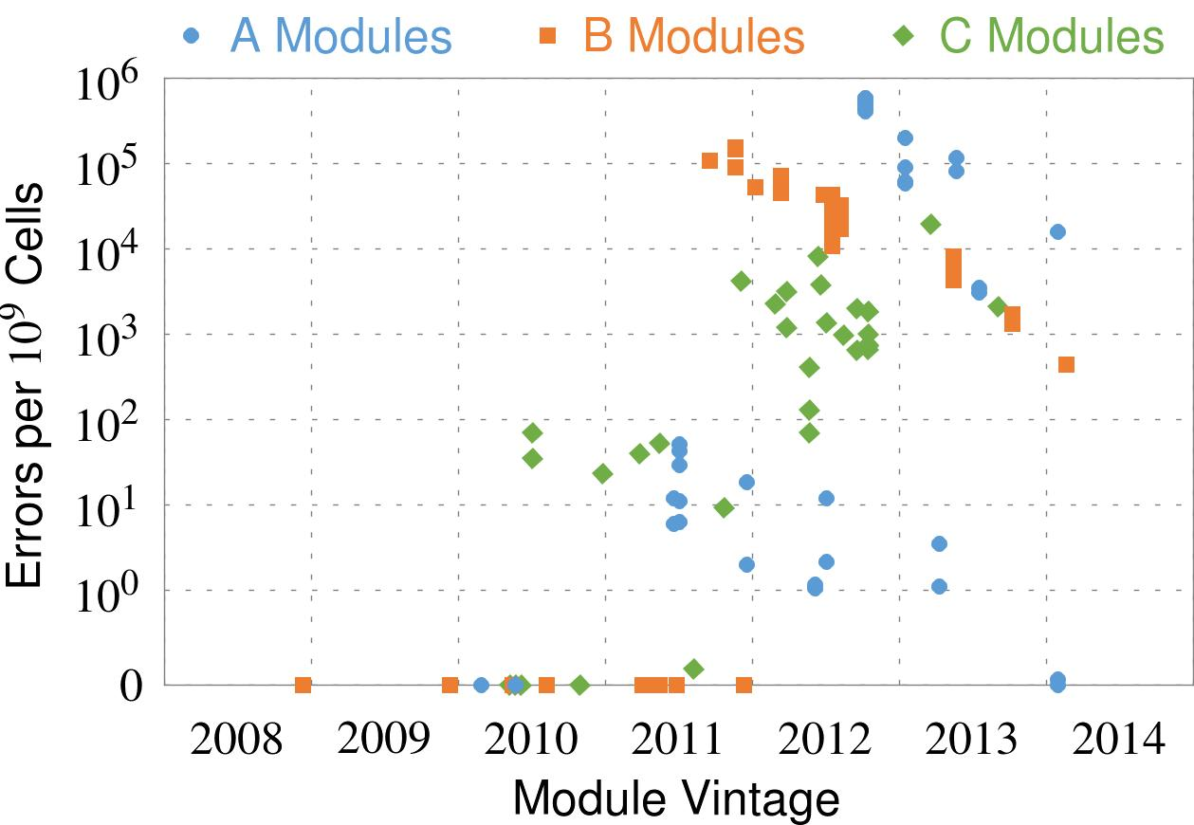
Recent DRAM Is More Vulnerable
Notes:
In this figure, the x-axis is the module manufacture date. And the y-axis is the number of errors in a module, normalized to one billion cells. In 2008 and 2009, there are no errors. But, in 2010, we first start to see errors in C modules. After 2010, the errors start to proliferate. For A and B modules, we first start to see errors in 2011. In particular, all modules from 2012 and 2013 are vulnerable.

Slide 20
Recent DRAM Is More Vulnerable
First
Appearance
Notes:
In this figure, the x-axis is the module manufacture date. And the y-axis is the number of errors in a module, normalized to one billion cells. In 2008 and 2009, there are no errors. But, in 2010, we first start to see errors in C modules. After 2010, the errors start to proliferate. For A and B modules, we first start to see errors in 2011. In particular, all modules from 2012 and 2013 are vulnerable.

Slide 21
Recent DRAM Is More Vulnerable
First
Appearance
All modules from 2012–2013 are vulnerable
Notes:
In this figure, the x-axis is the module manufacture date. And the y-axis is the number of errors in a module, normalized to one billion cells. In 2008 and 2009, there are no errors. But, in 2010, we first start to see errors in C modules. After 2010, the errors start to proliferate. For A and B modules, we first start to see errors in 2011. In particular, all modules from 2012 and 2013 are vulnerable.

Slide 22
Why Is This Happening?
DRAM cells are too close to each other!
They are not electrically isolated from each other
Access to one cell affects the value in nearby cells
due to electrical interference between
the cells
wires used for accessing the cells
Also called cell-to-cell coupling/interference
Example: When we activate (apply high voltage) to a row, an adjacent row gets slightly activated as well
Vulnerable cells in that slightly-activated row lose a little bit of charge
If row hammer happens enough times, charge in such cells gets drained

Slide 23
Higher-Level Implications
This simple circuit level failure mechanism has enormous implications on upper layers of the transformation hierarchy
Problem
Problem
Algorithm
Algorithm
Program/Language
User
Program/Language
Runtime System
(VM, OS, MM)
Runtime System
(VM, OS, MM)
ISA (Architecture)
ISA
Microarchitecture
Microarchitecture
Logic
Logic
Devices
Devices
Electrons
Electrons

Slide 24
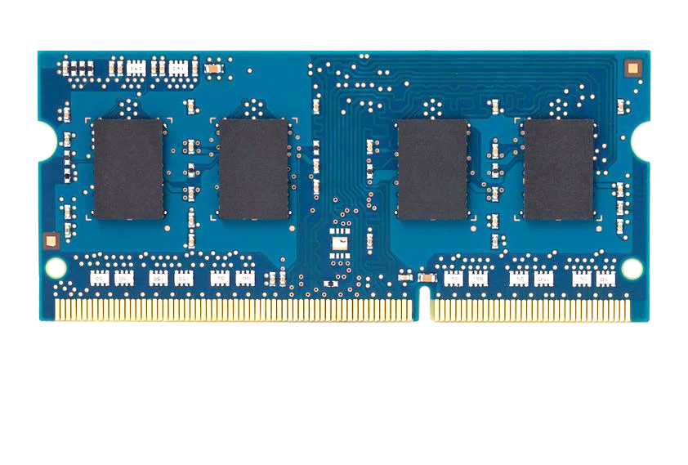
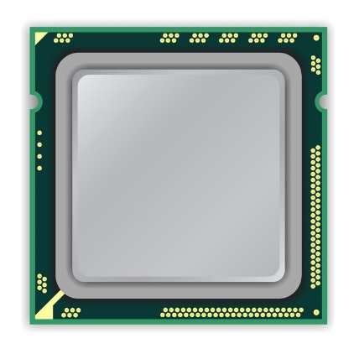
A Simple Program Can Induce Many Errors
CPU
DRAM Module
loop:
mov (X), %eax
mov (Y), %ebx
clflush (X)
clflush (Y)
mfence
jmp loop
X
Y
Download from: https://github.com/CMU-SAFARI/rowhammer
Notes:
We demonstrate the errors on multiple x86 systems. Shown to the bottom-left is a “disturbance kernel”. When executed, it forces two rows to be opened and closed one after the other – over and over again. Consequently, it induces many errors in the module.

Slide 25
A Simple Program Can Induce Many Errors
CPU
DRAM Module
Avoid cache hits
Flush X from cache
Avoid row hits to X
Read Y in another row
X
Y
Download from: https://github.com/CMU-SAFARI/rowhammer
Notes:
We demonstrate the errors on multiple x86 systems. Shown to the bottom-left is a “disturbance kernel”. When executed, it forces two rows to be opened and closed one after the other – over and over again. Consequently, it induces many errors in the module.

Slide 26
A Simple Program Can Induce Many Errors
CPU
DRAM Module
loop:
mov (X), %eax
mov (Y), %ebx
clflush (X)
clflush (Y)
mfence
jmp loop
X
Y
Download from: https://github.com/CMU-SAFARI/rowhammer
Notes:
We demonstrate the errors on multiple x86 systems. Shown to the bottom-left is a “disturbance kernel”. When executed, it forces two rows to be opened and closed one after the other – over and over again. Consequently, it induces many errors in the module.

Slide 27
A Simple Program Can Induce Many Errors
CPU
DRAM Module
loop:
mov (X), %eax
mov (Y), %ebx
clflush (X)
clflush (Y)
mfence
jmp loop
X
Y
Download from: https://github.com/CMU-SAFARI/rowhammer
Notes:
We demonstrate the errors on multiple x86 systems. Shown to the bottom-left is a “disturbance kernel”. When executed, it forces two rows to be opened and closed one after the other – over and over again. Consequently, it induces many errors in the module.

Slide 28
A Simple Program Can Induce Many Errors
CPU
DRAM Module
loop:
mov (X), %eax
mov (Y), %ebx
clflush (X)
clflush (Y)
mfence
jmp loop
X
Y
Download from: https://github.com/CMU-SAFARI/rowhammer
Notes:
We demonstrate the errors on multiple x86 systems. Shown to the bottom-left is a “disturbance kernel”. When executed, it forces two rows to be opened and closed one after the other – over and over again. Consequently, it induces many errors in the module.

Slide 29
Observed Errors in Real Systems
A real reliability & security issue
CPU Architecture | Errors | Access-Rate
Intel Haswell (2013) | 22.9K | 12.3M/sec
Intel Ivy Bridge (2012) | 20.7K | 11.7M/sec
Intel Sandy Bridge (2011) | 16.1K | 11.6M/sec
AMD Piledriver (2012) | 59 | 6.1M/sec
Kim+, “Flipping Bits in Memory Without Accessing Them: An Experimental Study of DRAM Disturbance Errors,” ISCA 2014.
Notes:
When we executed the code on four different processors, all four of them yielded errors. Intel Haswell has the most errors, at 23 thousand, because it has the highest rate of accessing DRAM.
Later on, I’ll show that we can induce as many as ten million disturbance errors in a more controlled environment.
From this, we conclude that disturbance errors are a serious reliability issue.

Slide 30
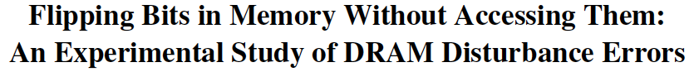
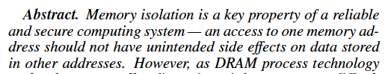
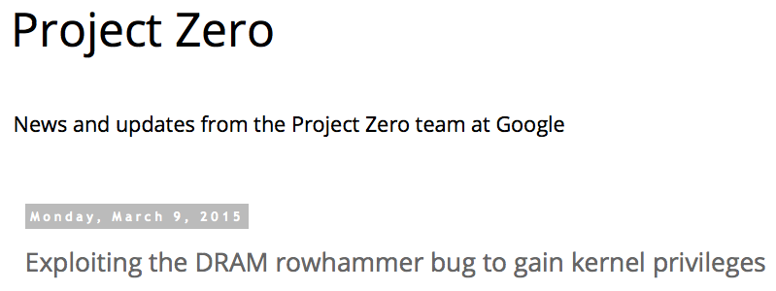
One Can Take Over an Otherwise-Secure System
Flipping Bits in Memory Without Accessing Them: An Experimental Study of DRAM Disturbance Errors (Kim et al., ISCA 2014)
Exploiting the DRAM rowhammer bug to gain kernel privileges (Seaborn, 2015)

Slide 31
RowHammer Security Attack Example
“Rowhammer” is a problem with some recent DRAM devices in which repeatedly accessing a row of memory can cause bit flips in adjacent rows (Kim et al., ISCA 2014).
Flipping Bits in Memory Without Accessing Them: An Experimental Study of DRAM Disturbance Errors (Kim et al., ISCA 2014)
We tested a selection of laptops and found that a subset of them exhibited the problem.
We built two working privilege escalation exploits that use this effect.
Exploiting the DRAM rowhammer bug to gain kernel privileges (Seaborn+, 2015)
One exploit uses rowhammer-induced bit flips to gain kernel privileges on x86-64 Linux when run as an unprivileged userland process.
When run on a machine vulnerable to the rowhammer problem, the process was able to induce bit flips in page table entries (PTEs).
It was able to use this to gain write access to its own page table, and hence gain read-write access to all of physical memory.
Exploiting the DRAM rowhammer bug to gain kernel privileges (Seaborn & Dullien, 2015)

Slide 32
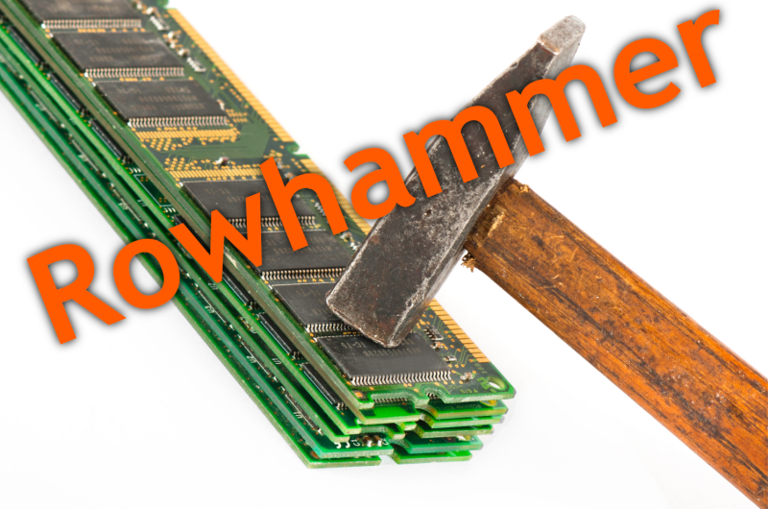
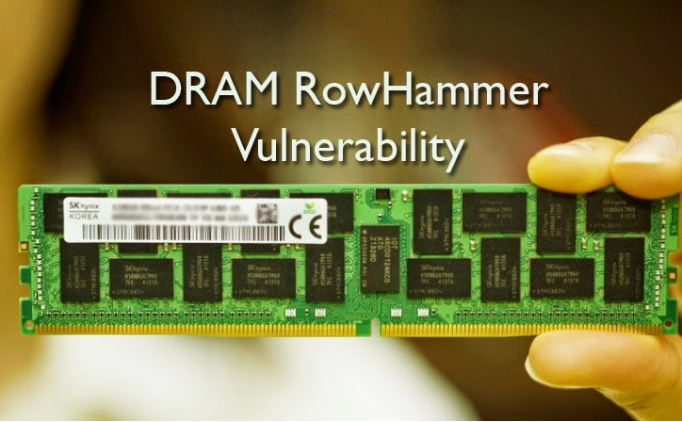
Security Implications
Notes:
Picture from the article:
http://thehackernews.com/2015/03/dram-rowhammer-vulnerability.html

Slide 33
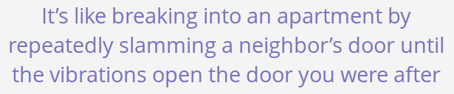
Security Implications
Notes:
Picture from the article:
http://thehackernews.com/2015/03/dram-rowhammer-vulnerability.html

Slide 34
Selected Readings on RowHammer (I)
Our first detailed study: Rowhammer analysis and solutions (June 2014)
Yoongu Kim, Ross Daly, Jeremie Kim, Chris Fallin, Ji Hye Lee, Donghyuk Lee, Chris Wilkerson, Konrad Lai, and Onur Mutlu, "Flipping Bits in Memory Without Accessing Them: An Experimental Study of DRAM Disturbance Errors" Proceedings of the 41st International Symposium on Computer Architecture (ISCA), Minneapolis, MN, June 2014. [Slides (pptx) (pdf)] [Lightning Session Slides (pptx) (pdf)] [Source Code and Data]
Our Source Code to Induce Errors in Modern DRAM Chips (June 2014)
https://github.com/CMU-SAFARI/rowhammer
Google Project Zero’s Attack to Take Over a System (March 2015)
Exploiting the DRAM rowhammer bug to gain kernel privileges (Seaborn+, 2015)
https://github.com/google/rowhammer-test
Double-sided Rowhammer

Slide 35
Selected Readings on RowHammer (II)
Remote RowHammer Attacks via JavaScript (July 2015)
http://arxiv.org/abs/1507.06955
https://github.com/IAIK/rowhammerjs
Gruss et al., DIMVA 2016.
CLFLUSH-free Rowhammer
“A fully automated attack that requires nothing but a website with JavaScript to trigger faults on remote hardware.”
“We can gain unrestricted access to systems of website visitors.”
ANVIL: Software-Based Protection Against Next-Generation Rowhammer Attacks (March 2016)
http://dl.acm.org/citation.cfm?doid=2872362.2872390
Aweke et al., ASPLOS 2016
CLFLUSH-free Rowhammer
Software based monitoring for rowhammer detection

Slide 36
Selected Readings on RowHammer (III)
Dedup Est Machina: Memory Deduplication as an Advanced Exploitation Vector (May 2016)
https://www.ieee-security.org/TC/SP2016/papers/0824a987.pdf
Bosman et al., IEEE S&P 2016.
Exploits Rowhammer and Memory Deduplication to overtake a browser
“We report on the first reliable remote exploit for the Rowhammer vulnerability running entirely in Microsoft Edge.”
“[an attacker] … can reliably “own” a system with all defenses up, even if the software is entirely free of bugs.”

Slide 37
Selected Readings on RowHammer (IV)
Flip Feng Shui: Hammering a Needle in the Software Stack (August 2016)
https://www.usenix.org/system/files/conference/usenixsecurity16/sec16_paper_razavi.pdf
Razavi et al., USENIX Security 2016.
Combines memory deduplication and RowHammer
“A malicious VM can gain unauthorized access to a co-hosted VM running OpenSSH.”
Breaks OpenSSH public key authentication
Drammer: Deterministic Rowhammer Attacks on Mobile Platforms (October 2016)
http://dl.acm.org/citation.cfm?id=2976749.2978406
Van Der Veen et al., CCS 2016
Can take over an ARM-based Android system deterministically
Exploits predictable physical memory allocator behavior
Can deterministically place security-sensitive data (e.g., page table) in an attacker-chosen, vulnerable location in memory

Slide 38
Selected Readings on RowHammer (V)
Grand Pwning Unit: Accelerating Microarchitectural Attacks with the GPU (May 2018)
https://www.vusec.net/wp-content/uploads/2018/05/glitch.pdf
Frigo et al., IEEE S&P 2018.
The first end-to-end remote Rowhammer exploit on mobile platforms that use our GPU-based primitives in orchestration to compromise browsers on mobile devices in under two minutes.
Throwhammer: Rowhammer Attacks over the Network and Defenses (July 2018)
https://www.cs.vu.nl/~herbertb/download/papers/throwhammer_atc18.pdf
Tatar et al., USENIX ATC 2018.
“[We] show that an attacker can trigger and exploit Rowhammer bit flips directly from a remote machine by only sending network packets.”

Slide 39
Selected Readings on RowHammer (VI)
Nethammer: Inducing Rowhammer Faults through Network Requests (July 2018)
https://arxiv.org/pdf/1805.04956.pdf
Lipp et al., arxiv.org 2018.
“Nethammer is the first truly remote Rowhammer attack, without a single attacker-controlled line of code on the targeted system.”

Slide 40

More Security Implications (I)
“We can gain unrestricted access to systems of website visitors.”
Rowhammer.js: A Remote Software-Induced Fault Attack in JavaScript (DIMVA’16)
Source: https://lab.dsst.io/32c3-slides/7197.html

Slide 41

More Security Implications (II)
“Can gain control of a smart phone deterministically”
Drammer: Deterministic Rowhammer Attacks on Mobile Platforms, CCS’16
Source: https://fossbytes.com/drammer-rowhammer-attack-android-root-devices/

Slide 42
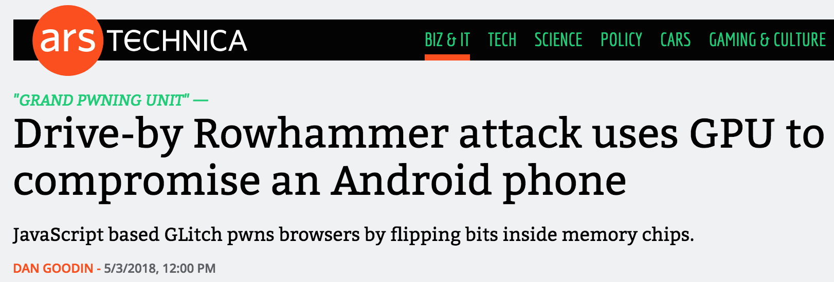

More Security Implications (III)
Using an integrated GPU in a mobile system to remotely escalate privilege via the WebGL interface

Slide 43
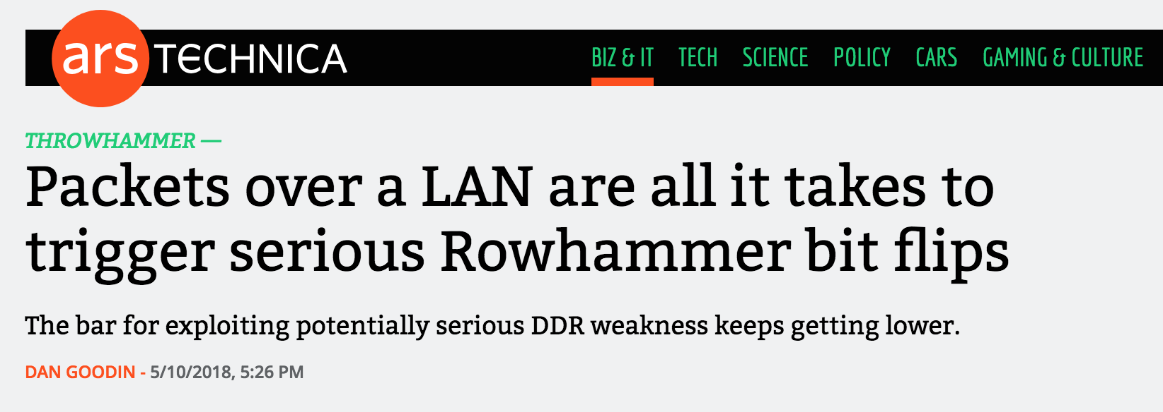
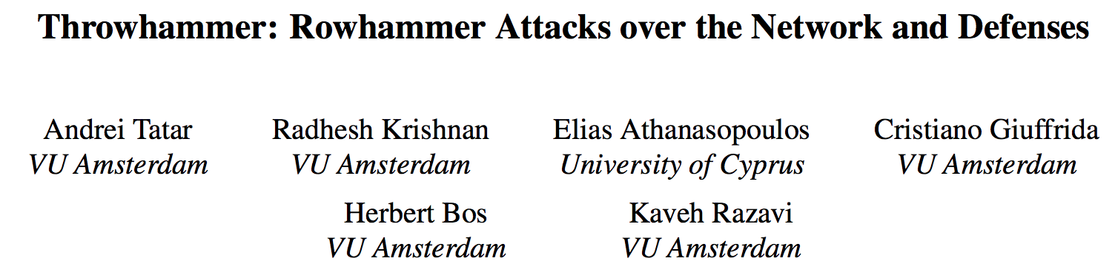
More Security Implications (IV)
Rowhammer over RDMA (I)

Slide 44


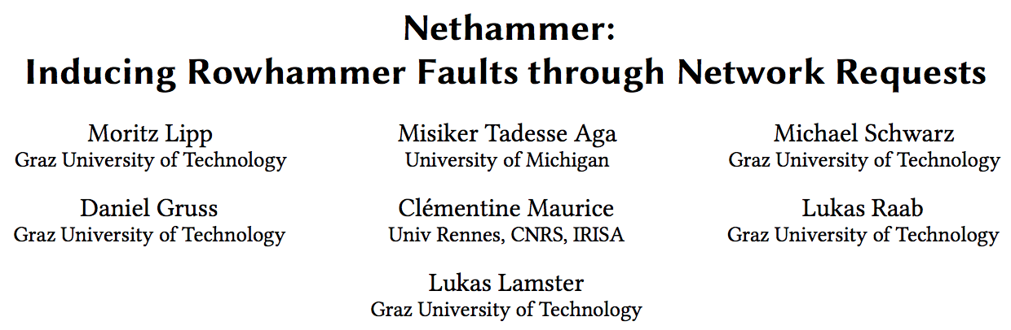
More Security Implications (V)
Rowhammer over RDMA (II)

Slide 45
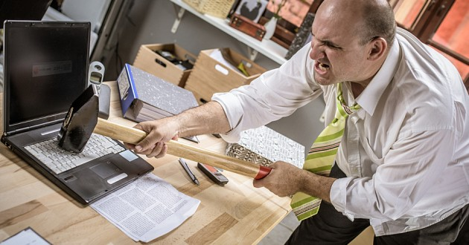
More Security Implications?

Slide 46
Understanding RowHammer

Slide 47
Root Causes of Disturbance Errors
Cause 1: Electromagnetic coupling
Toggling the wordline voltage briefly increases the voltage of adjacent wordlines
Slightly opens adjacent rows → Charge leakage
Cause 2: Conductive bridges
Cause 3: Hot-carrier injection
Confirmed by at least one manufacturer
Notes:
Why do the errors occur? We see three possible causes.
First, there could electromagnetic coupling between adjacent wordlines. When the voltage of one is toggled, it could briefly increase the voltage of the other and facilitate the leakage of charge.
Two other possibilities are conductive bridges and hot-carrier injection.
At least one manufacturer confirmed that these three could play a role in the disturbance errors we see them today.

Slide 48
Experimental DRAM Testing Infrastructure
An Experimental Study of Data Retention Behavior in Modern DRAM Devices: Implications for Retention Time Profiling Mechanisms (Liu et al., ISCA 2013)
The Efficacy of Error Mitigation Techniques for DRAM Retention Failures: A Comparative Experimental Study
(Khan et al., SIGMETRICS 2014)
Flipping Bits in Memory Without Accessing Them: An Experimental Study of DRAM Disturbance Errors (Kim et al., ISCA 2014)
Adaptive-Latency DRAM: Optimizing DRAM Timing for the Common-Case (Lee et al., HPCA 2015)
AVATAR: A Variable-Retention-Time (VRT) Aware Refresh for DRAM Systems (Qureshi et al., DSN 2015)

Slide 49
Experimental DRAM Testing Infrastructure
Temperature
Controller
FPGAs
Heater
FPGAs
PC
Kim+, “Flipping Bits in Memory Without Accessing Them: An Experimental Study of DRAM Disturbance Errors,” ISCA 2014.

Slide 50
RowHammer Characterization Results
Most Modules Are at Risk
Errors vs. Vintage
Error = Charge Loss
Adjacency: Aggressor & Victim
Sensitivity Studies
Other Results in Paper
Solution Space
Flipping Bits in Memory Without Accessing Them: An Experimental Study of DRAM Disturbance Errors, (Kim et al., ISCA 2014)
Notes:
Now I will present the characterization results, one-by-one.
First, I show that most modules are at risk. Second, I show the number of errors in a module as a function of the manufacture date. Third, I show that the errors are symptomatic of charge loss. Fourth, I show that an aggressor induces errors in adjacent rows. Fifth, I show several sensitivity studies. And, finally, I briefly describe other results in the paper.

Slide 51
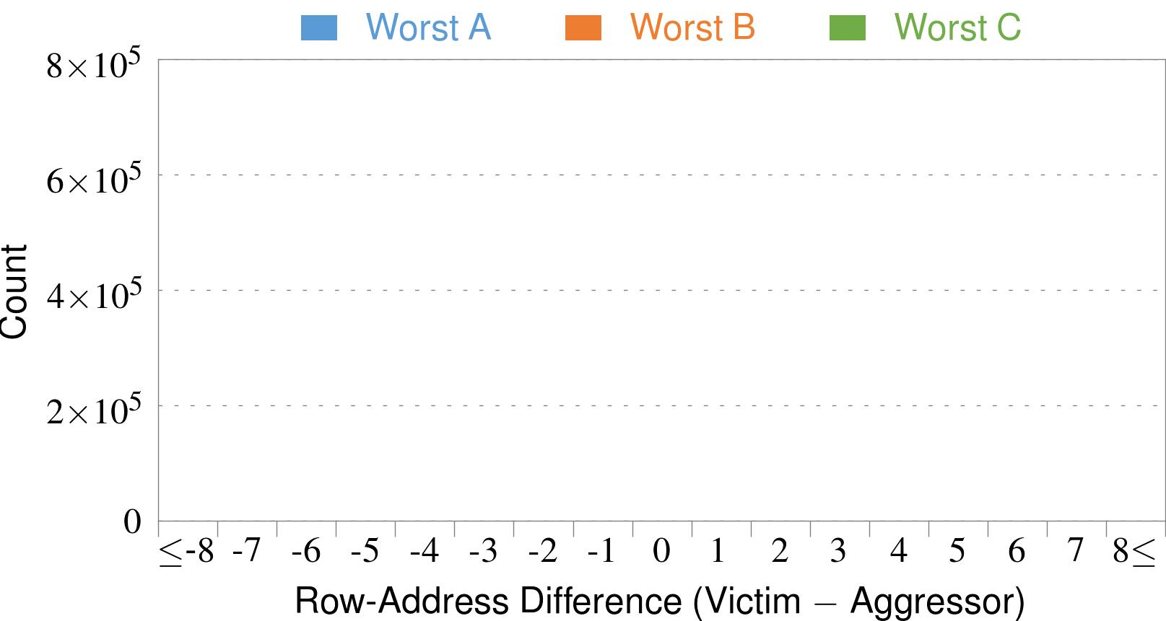
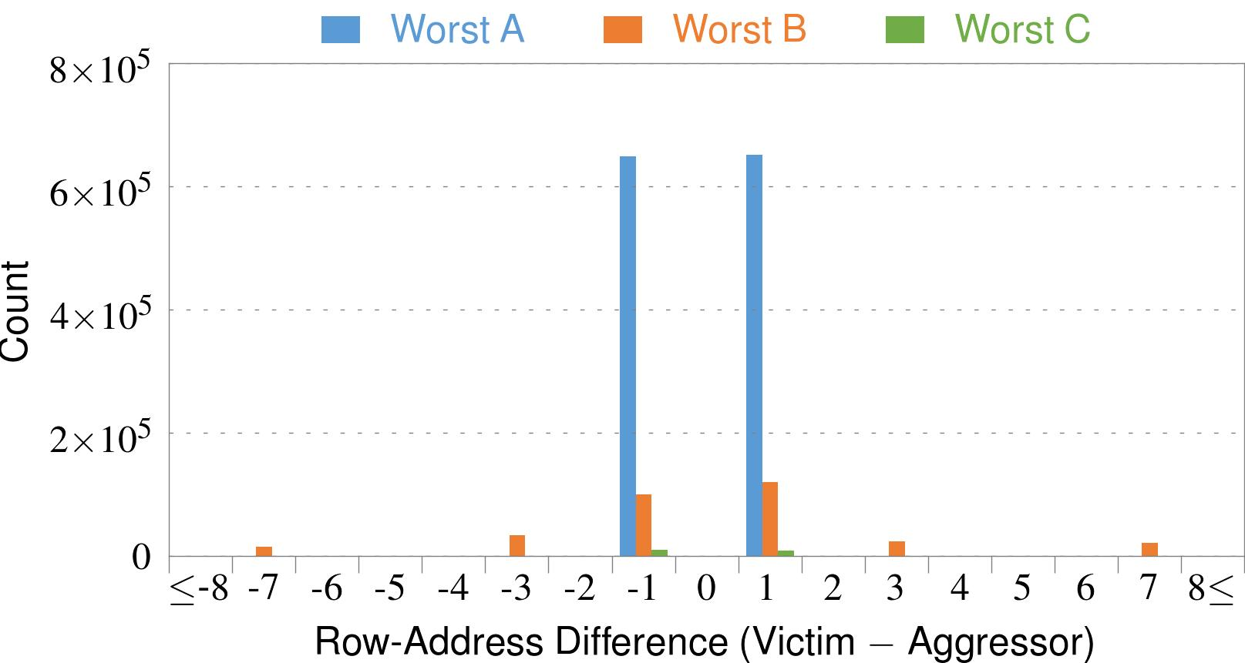
4. Adjacency: Aggressor & Victim
Adjacent
Adjacent
Adjacent
Non-Adjacent
Non-Adjacent
Note: For three modules with the most errors (only first bank)
Most aggressors & victims are adjacent
Notes:
In this figure, the x-axis is the row-address difference between an aggressor and its victims. And the y-axis is the number of victim-aggressor pairs that correspond to the row-address difference. For all three modules, we see strong peaks at plus/minus 1. This implies that aggressors and victims have consecutive row-addresses, in other words, they are adjacent.
However, the figure also shows some victims that are not adjacent to the aggressor. We believe this could be caused by two reasons. First, depending on the mapping, two rows that are physically adjacent within the DRAM chip may not have consecutive row-addresses. Second, fault rows are often re-mapped to spare rows that may reside on a different portion of the DRAM chip.
Nevertheless, we conclude that the vast majority of aggressors & victims are adjacent.

Slide 52
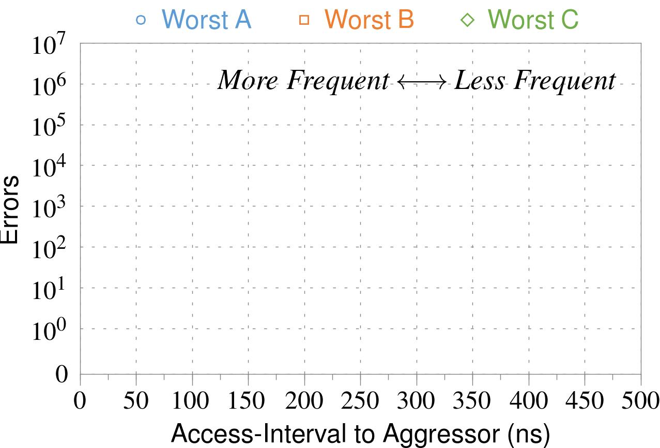
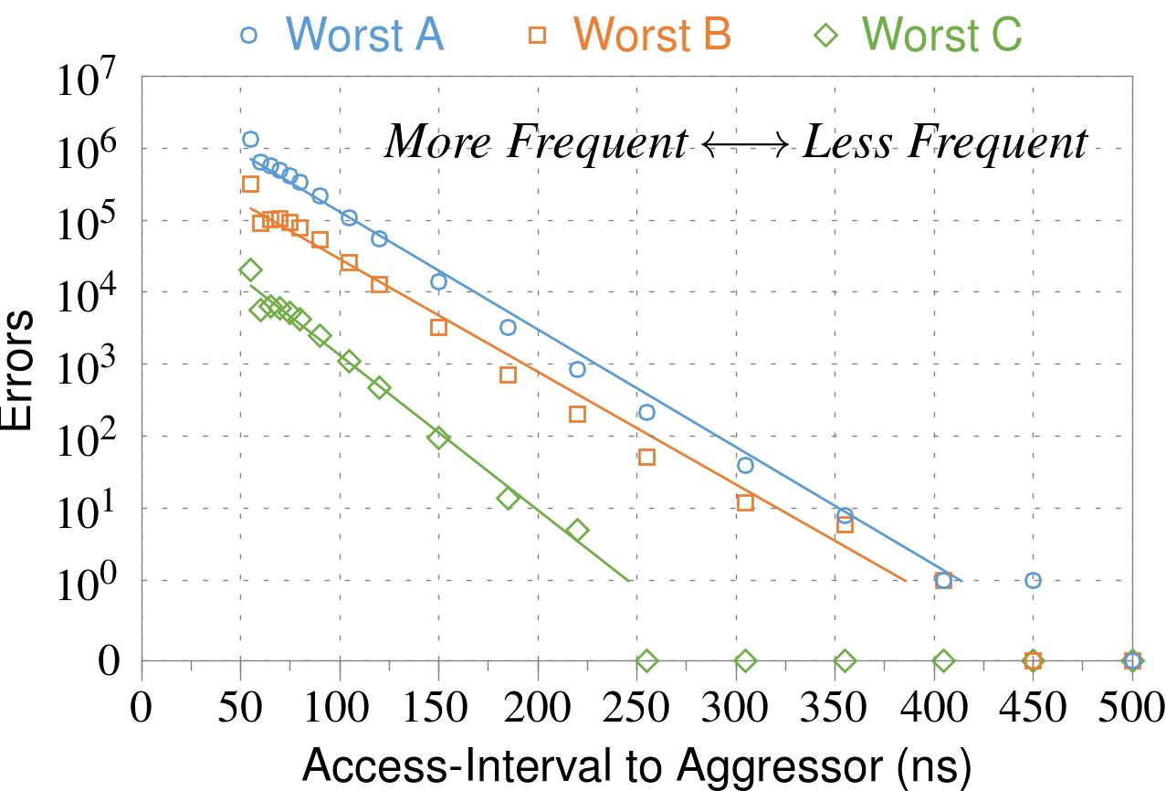
❶ Access Interval (Aggressor)
Not Allowed
500ns
55ns
Note: For three modules with the most errors (only first bank)
Less frequent accesses → Fewer errors
Notes:
In this figure, the x-axis is the interval at which we access the aggressor. And the y-axis is the number of errors. To comply with the DRAM standard, we employ a default value of 55ns in our experiments. However, as we increase the access-interval, we see that the number of errors decreases. In particular, at 500ns, there are no errors for all three modules.
From this, we conclude that less frequent accesses induce fewer errors.

Slide 53
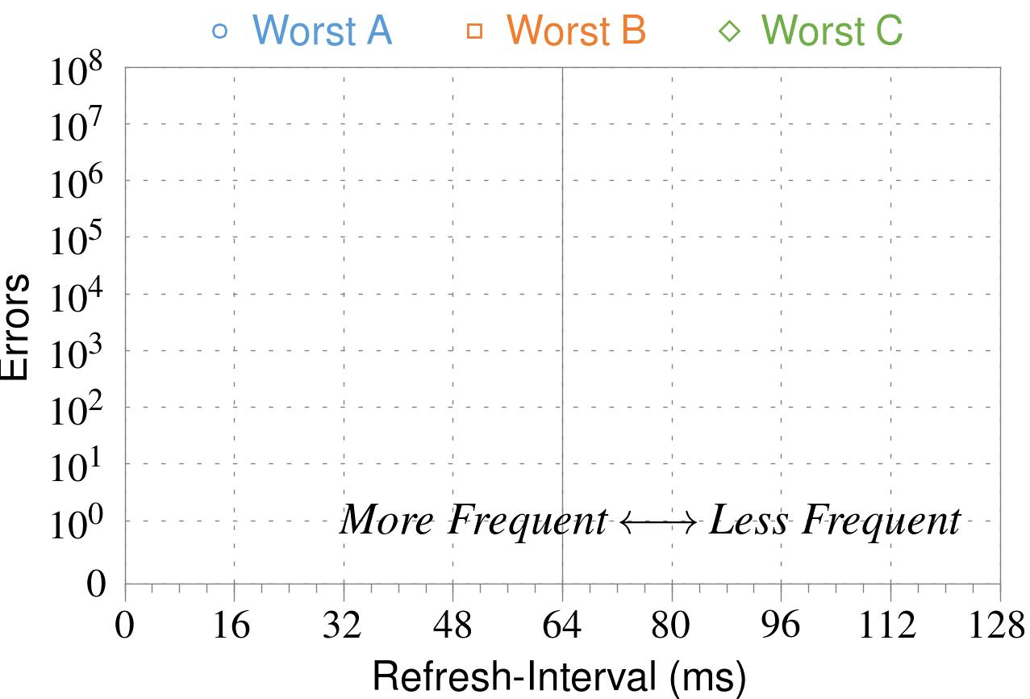
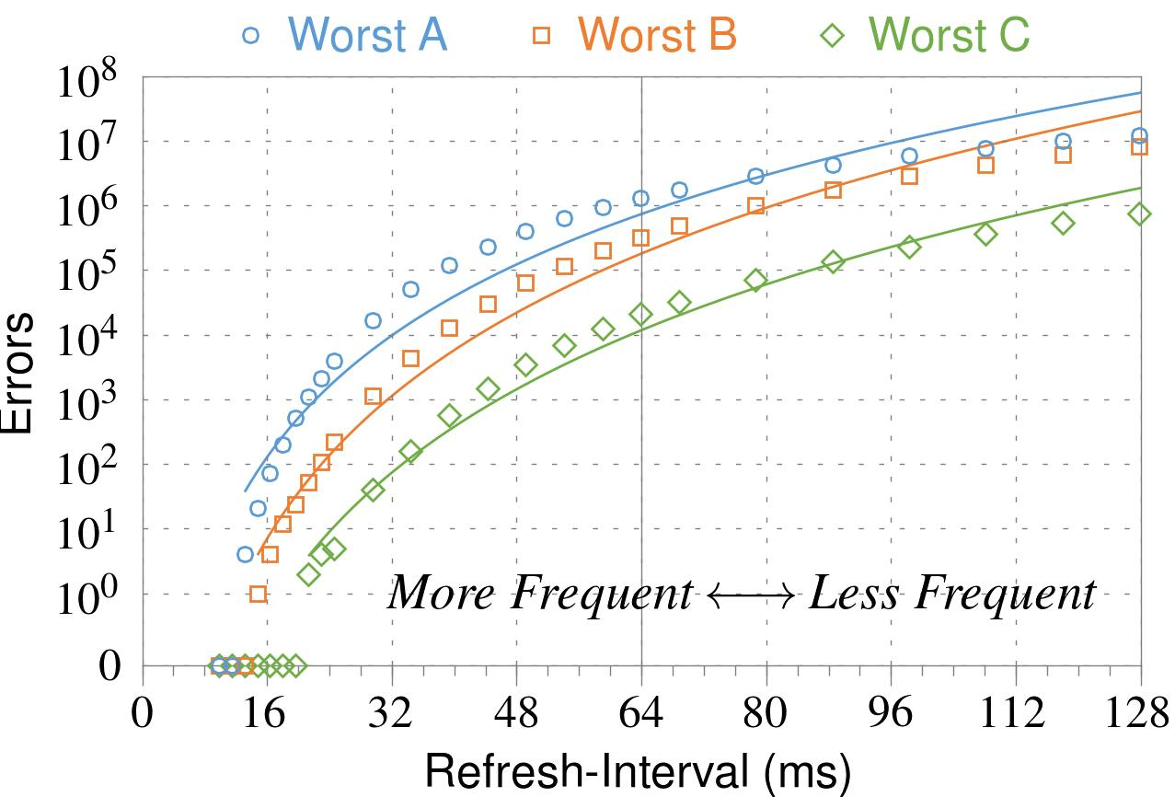
❷ Refresh Interval
~7x frequent
64ms
Note: Using three modules with the most errors (only first bank)
More frequent refreshes → Fewer errors
Notes:
In this figure, the x-axis is the refresh-interval. And the y-axis is the number of errors. To comply with the DRAM standard, we employ a default value of 64ms in our experiments. However, as we decrease the refresh-interval, we see that the number of errors decreases. In particular, when the refresh is shortened by 7x, there are no errors for all three modules.
From this, we conclude that more frequent accesses induce fewer errors.

Slide 54
❸ Data Pattern
Solid
RowStripe
111111
111111
111111
000000
111111
111111
10x Errors
111111
000000
~Solid
~RowStripe
000000
000000
000000
111111
000000
000000
000000
111111
Errors affected by data stored in other cells
Notes:
We tested the modules with four different data-patterns: Solid, inverse Solid, RowStripe, and inverse RowStripe. Solid and inverse Solid give us full coverage since each cell is tested with both 1s and 0s. And the same applies to RowStripe and its inverse.
However, we found that the rowstripe pattern had 10 times as more errors than the solid pattern. We also tested many other data-patterns, including random, but found RowStripe to induce the most errors.
Therefore, we conclude that errors are affected by data stored in other cells due to differences in coupling effects between the cells.

Slide 55
6. Other Results (in Paper)
Victim Cells ≠ Weak Cells (i.e., leaky cells)
Almost no overlap between them
Errors not strongly affected by temperature
Default temperature: 50°C
At 30°C and 70°C, number of errors changes <15%
Errors are repeatable
Across ten iterations of testing, >70% of victim cells had errors in every iteration
Notes:
First, we show that victim cells are not weak cells, which are cells that are inherently leaky. According to our experiments, we saw almost no overlap between them.
Second, we show that errors are not strongly affected by temperature. In all of the tests so far, we set the temperature to 50 degrees Celsius. But even when we changed the temperature by 20 degrees, the number of errors changed by less than 15 percent.
Third, we show that errors are repeatable. Across ten iterations of testing, more than 70% of victim cells had errors in every iteration.

Slide 56
6. Other Results (in Paper) cont’d
As many as 4 errors per cache-line
Simple ECC (e.g., SECDED) cannot prevent all errors
Number of cells & rows affected by aggressor
Victims cells per aggressor: ≤110
Victims rows per aggressor: ≤9
Cells affected by two aggressors on either side
Very small fraction of victim cells (<100) have an error when either one of the aggressors is toggled
Notes:
Fourth, we show that there are as many as four errors per cacheline. From this, we conclude that simple ECC schemes (for example, SECDED) cannot prevent all errors.
Fifth, we show that the number of cells & rows affected by an aggressor can be as high as 110 or 9, respectively.
Lastly, we show that a very small fraction of victim cells experience an error when either one of the aggressors is toggled.

Slide 57
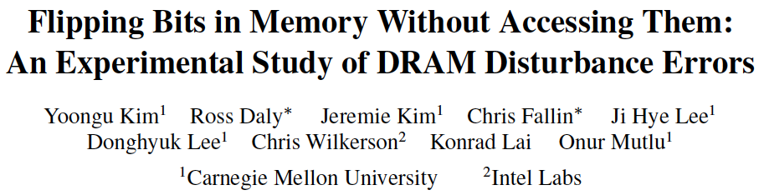
More on RowHammer Analysis
Yoongu Kim, Ross Daly, Jeremie Kim, Chris Fallin, Ji Hye Lee, Donghyuk Lee, Chris Wilkerson, Konrad Lai, and Onur Mutlu, "Flipping Bits in Memory Without Accessing Them: An Experimental Study of DRAM Disturbance Errors" Proceedings of the 41st International Symposium on Computer Architecture (ISCA), Minneapolis, MN, June 2014. [Slides (pptx) (pdf)] [Lightning Session Slides (pptx) (pdf)] [Source Code and Data]

Slide 58
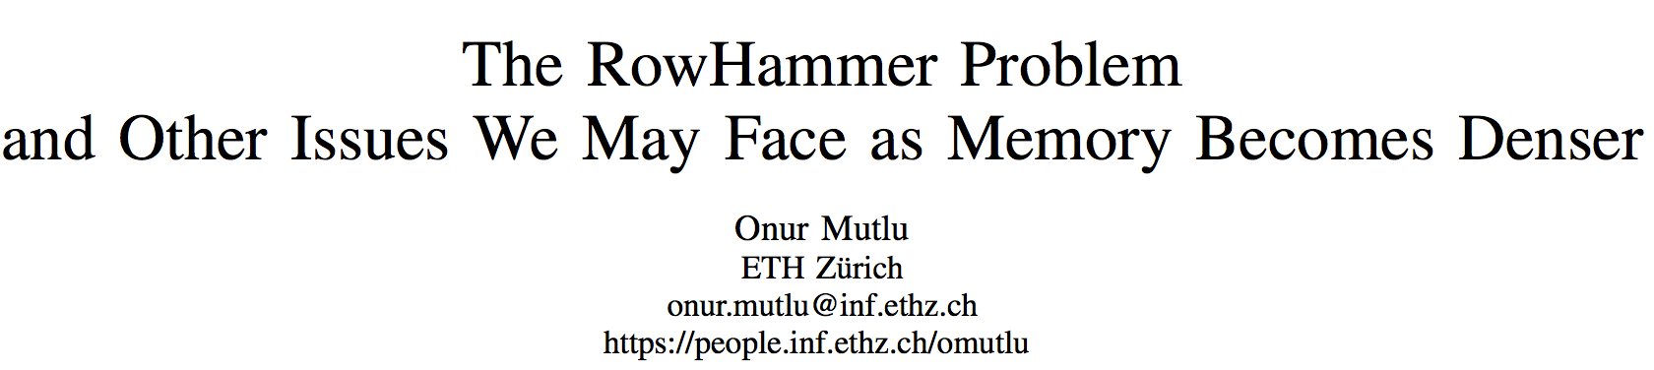
Retrospective on RowHammer & Future
Onur Mutlu, "The RowHammer Problem and Other Issues We May Face as Memory Becomes Denser" Invited Paper in Proceedings of the Design, Automation, and Test in Europe Conference (DATE), Lausanne, Switzerland, March 2017. [Slides (pptx) (pdf)]
https://people.inf.ethz.ch/omutlu/pub/rowhammer-and-other-memory-issues_date17.pdf

Slide 59
RowHammer Solutions

Slide 60
Some Potential Solutions
Cost
Make better DRAM chips
Power, Performance
Refresh frequently
Cost, Power
Sophisticated ECC
Cost, Power, Complexity
Access counters
Notes:
Here is a list of four potential solutions to disturbance errors: making better DRAM chips, refreshing more frequently, employing sophisticated ECC schemes, and using hardware counters to track the number of accesses to different rows.
However, all of these solutions incur a large overhead in terms cost, power, performance, and/or complexity.

Slide 61
Naive Solutions
❶ Throttle accesses to same row
Limit access-interval: ≥500ns
Limit number of accesses: ≤128K (=64ms/500ns)
❷ Refresh more frequently
Shorten refresh-interval by ~7x
Both naive solutions introduce significant overhead in performance and power
Notes:
Based on what we learned from the sensitivity studies, there are two naive solutions that immediately present themselves.
First, we can throttle accesses to the same row. If the access-interval is greater than 500ns, I showed how errors are not induced. We can achieve the same effect by limiting the maximum number of accesses to the same row to be less than 128K, within a refresh interval.
Second, we can refresh the module more frequently. If the refresh-interval is shortened by 7x, I showed how errors can be prevented.
However, both naive solutions introduce significant overhead in both performance and power. Later on, I will propose a much more efficient solution.

Slide 62
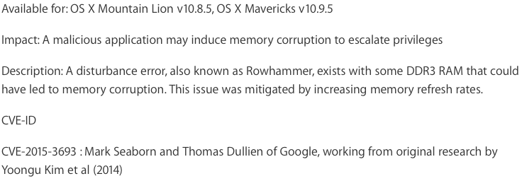
Apple’s Patch for RowHammer
https://support.apple.com/en-gb/HT204934
HP, Lenovo, and other vendors released similar patches

Slide 63
Our Solution to RowHammer
PARA: Probabilistic Adjacent Row Activation
Key Idea
After closing a row, we activate (i.e., refresh) one of its neighbors with a low probability: p = 0.005
Reliability Guarantee
When p=0.005, errors in one year: 9.4×10⁻¹⁴
By adjusting the value of p, we can vary the strength of protection against errors
Notes:
We provide a more efficient solution, called PARA, which stands for probabilistic adjacent row activation.
The key idea is thus: after closing a row, we activate (i.e., refresh) one of its neighbors with a low probability, for example, p equal to 0.005.
PARA provides a strong reliability guarantee even under the worst-case access patterns to DRAM. When we set p to 0.005, the expected number of errors in one year is 9.4 times 10 to the negative 14. This probability is much lower the failure rate of other hardware components, for example, the hard-disk drive.
And by adjusting the value of p, PARA can provide an arbitrarily strong-degree of protection against errors.

Slide 64
Advantages of PARA
PARA refreshes rows infrequently
Low power
Low performance-overhead
Average slowdown: 0.20% (for 29 benchmarks)
Maximum slowdown: 0.75%
PARA is stateless
Low cost
Low complexity
PARA is an effective and low-overhead solution to prevent disturbance errors
Notes:
PARA has many advantages. Since it refreshes row infrequently, it has low power and low performance-overhead. Simulated across 29 benchmarks, we saw an average of only 0.2% slowdown and a maximum of only 0.75% slowdown.
In addition, due to its stateless nature, PARA has low cost and complexity.
Therefore, PARA is an effective and low-overhead solution to prevent disturbance errors.

Slide 65
Requirements for PARA
If implemented in DRAM chip
Enough slack in timing parameters
Plenty of slack today:
Lee et al., “Adaptive-Latency DRAM: Optimizing DRAM Timing for the Common Case,” HPCA 2015.
Chang et al., “Understanding Latency Variation in Modern DRAM Chips,” SIGMETRICS 2016.
Lee et al., “Design-Induced Latency Variation in Modern DRAM Chips,” SIGMETRICS 2017.
Chang et al., “Understanding Reduced-Voltage Operation in Modern DRAM Devices,” SIGMETRICS 2017.
Ghose et al., “What Your DRAM Power Models Are Not Telling You: Lessons from a Detailed Experimental Study,” SIGMETRICS 2018.
If implemented in memory controller
Better coordination between memory controller and DRAM
Memory controller should know which rows are physically adjacent

Slide 66
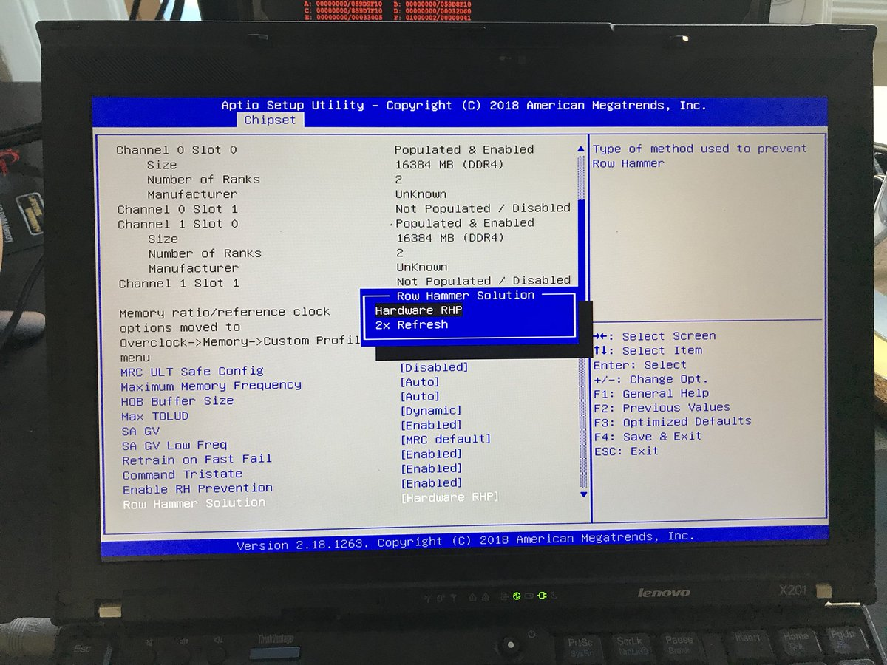
Probabilistic Activation in Real Life (I)
https://twitter.com/isislovecruft/status/1021939922754723841

Slide 67
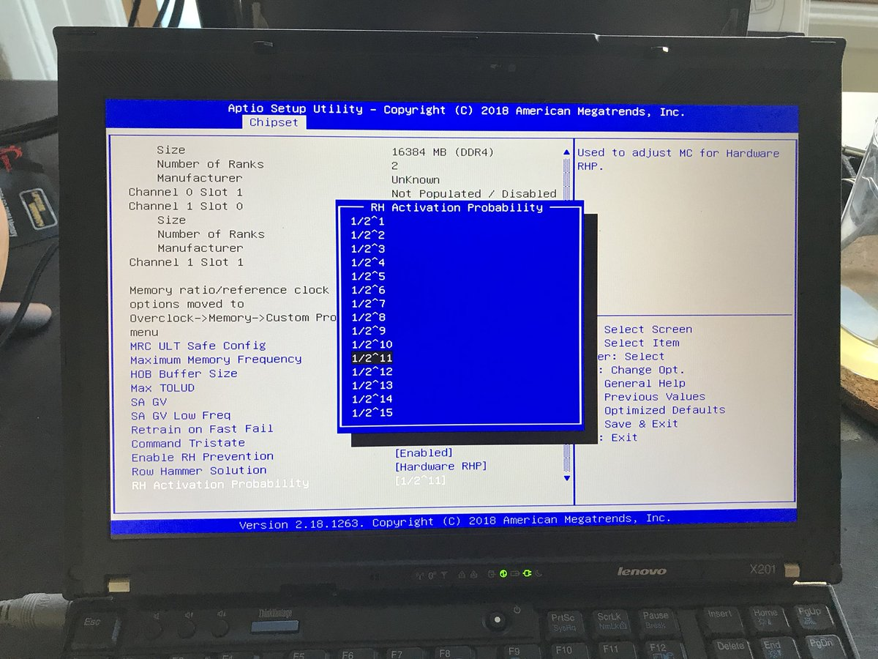
Probabilistic Activation in Real Life (II)
https://twitter.com/isislovecruft/status/1021939922754723841

Slide 68
More on RowHammer Analysis
Yoongu Kim, Ross Daly, Jeremie Kim, Chris Fallin, Ji Hye Lee, Donghyuk Lee, Chris Wilkerson, Konrad Lai, and Onur Mutlu, "Flipping Bits in Memory Without Accessing Them: An Experimental Study of DRAM Disturbance Errors" Proceedings of the 41st International Symposium on Computer Architecture (ISCA), Minneapolis, MN, June 2014. [Slides (pptx) (pdf)] [Lightning Session Slides (pptx) (pdf)] [Source Code and Data]

Slide 69
Future of Memory Reliability
Onur Mutlu, "The RowHammer Problem and Other Issues We May Face as Memory Becomes Denser" Invited Paper in Proceedings of the Design, Automation, and Test in Europe Conference (DATE), Lausanne, Switzerland, March 2017. [Slides (pptx) (pdf)]
https://people.inf.ethz.ch/omutlu/pub/rowhammer-and-other-memory-issues_date17.pdf

Slide 70
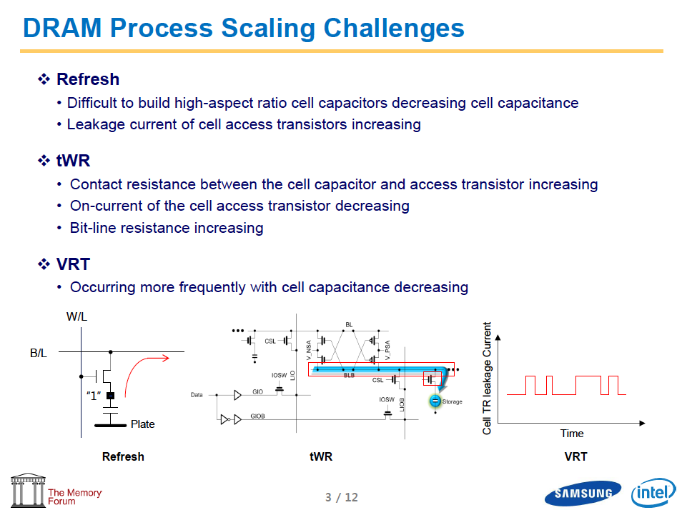
Industry Is Writing Papers About It, Too

Slide 71
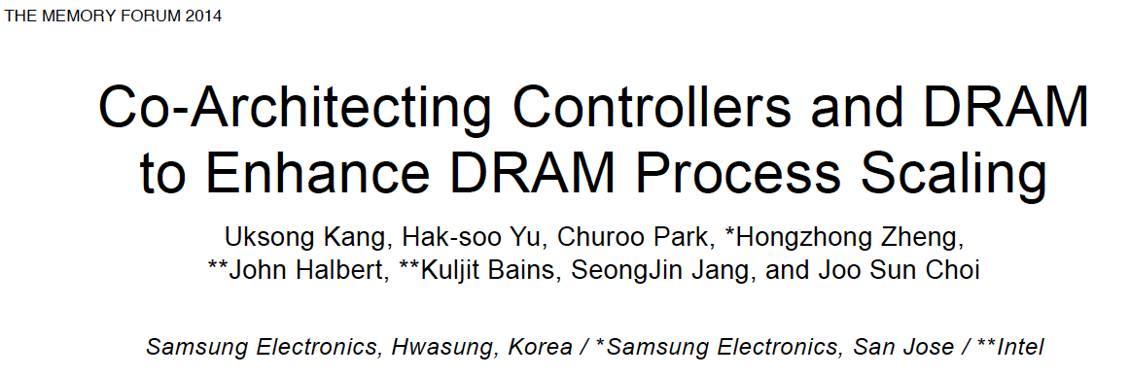
Call for Intelligent Memory Controllers

Slide 72
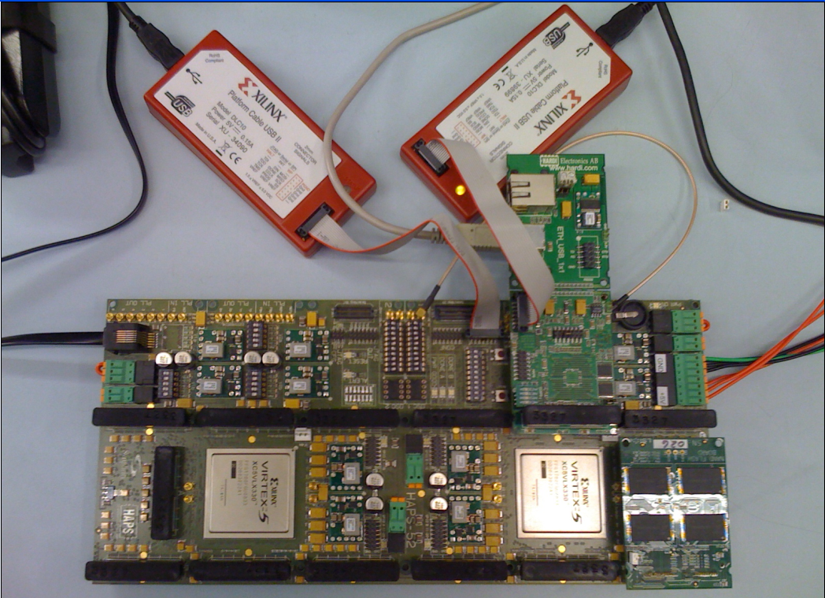
Aside: Intelligent Controller for NAND Flash
USB Daughter Board
USB Jack
HAPS-52 Mother Board
Virtex-II Pro
(USB controller)
1x-nm
NAND Flash
Virtex-V FPGA
(NAND Controller)
[DATE 2012, ICCD 2012, DATE 2013, ITJ 2013, ICCD 2013, SIGMETRICS 2014, HPCA 2015, DSN 2015, MSST 2015, JSAC 2016, HPCA 2017, DFRWS 2017,
PIEEE 2017, HPCA 2018, SIGMETRICS 2018]
NAND Daughter Board
Cai+, “Error Characterization, Mitigation, and Recovery in Flash Memory Based Solid State Drives,” Proc. IEEE 2017.

Slide 73
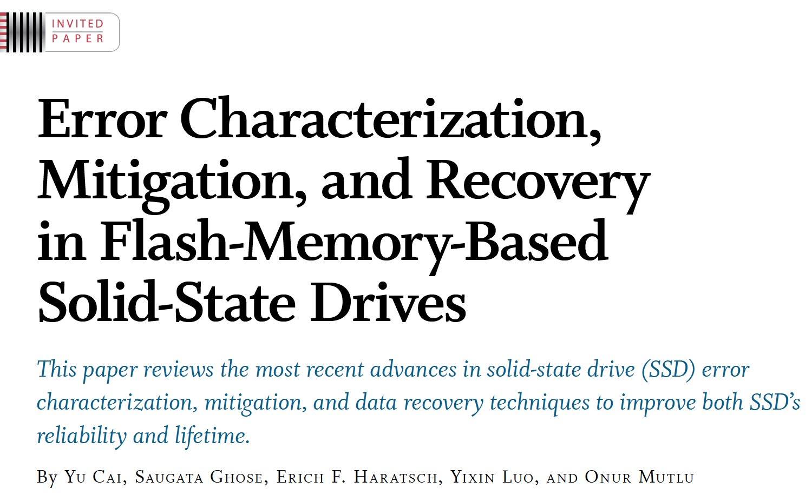

Aside: Intelligent Controller for NAND Flash
Proceedings of the IEEE, Sept. 2017
https://arxiv.org/pdf/1706.08642

Slide 74
A Key Takeaway
Main Memory Needs
Intelligent Controllers

Slide 75
Challenge and Opportunity for Future
Fundamentally
Secure, Reliable, Safe
Computing Architectures

Slide 76
Some Thoughts on RowHammer
A simple hardware failure mechanism can create a widespread system security vulnerability
How to exploit and fix the vulnerability requires a strong understanding across the transformation layers
And, a strong understanding of tools available to you
Fixing needs to happen for two types of chips
Existing chips (already in the field)
Future chips
Mechanisms for fixing are different between the two types

Slide 77
Aside: Byzantine Failures
This class of failures is known as Byzantine failures
Characterized by
Undetected erroneous computation
Opposite of “fail fast (with an error or no result)”
“erroneous” can be “malicious” (intent is the only distinction)
Very difficult to detect and confine Byzantine failures
Do all you can to avoid them
Lamport et al., “The Byzantine Generals Problem,” ACM TOPLAS 1982.
Slide credit: Mahadev Satyanarayanan, CMU, 15-440, Spring 2015

Slide 78
Future Memory Reliability/Security Challenges

Slide 79
Future of Main Memory
DRAM is becoming less reliable → more vulnerable

Slide 80
Large-Scale Failure Analysis of DRAM Chips
Analysis and modeling of memory errors found in all of Facebook’s server fleet
Justin Meza, Qiang Wu, Sanjeev Kumar, and Onur Mutlu, "Revisiting Memory Errors in Large-Scale Production Data Centers: Analysis and Modeling of New Trends from the Field" Proceedings of the 45th Annual IEEE/IFIP International Conference on Dependable Systems and Networks (DSN), Rio de Janeiro, Brazil, June 2015. [Slides (pptx) (pdf)] [DRAM Error Model]

Slide 81
DRAM Reliability Reducing
Intuition: quadratic increase in capacity
Meza+, “Revisiting Memory Errors in Large-Scale Production Data Centers,” DSN’15.

Slide 82
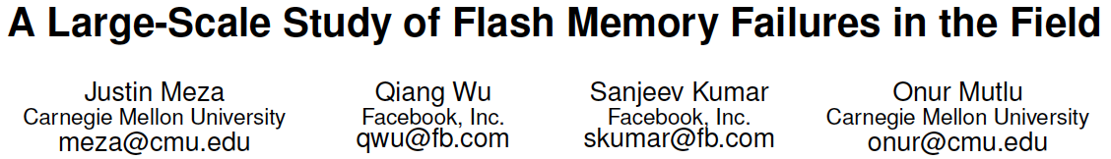
Aside: SSD Error Analysis in the Field
First large-scale field study of flash memory errors
Justin Meza, Qiang Wu, Sanjeev Kumar, and Onur Mutlu, "A Large-Scale Study of Flash Memory Errors in the Field" Proceedings of the ACM International Conference on Measurement and Modeling of Computer Systems (SIGMETRICS), Portland, OR, June 2015. [Slides (pptx) (pdf)] [Coverage at ZDNet]

Slide 83
Future of Main Memory
DRAM is becoming less reliable → more vulnerable
Due to difficulties in DRAM scaling, other problems may also appear (or they may be going unnoticed)
Some errors may already be slipping into the field
Read disturb errors (Rowhammer)
Retention errors
Read errors, write errors
…
These errors can also pose security vulnerabilities

Slide 84
DRAM Data Retention Time Failures
Determining the data retention time of a cell/row is getting more difficult
Retention failures may already be slipping into the field

Slide 85
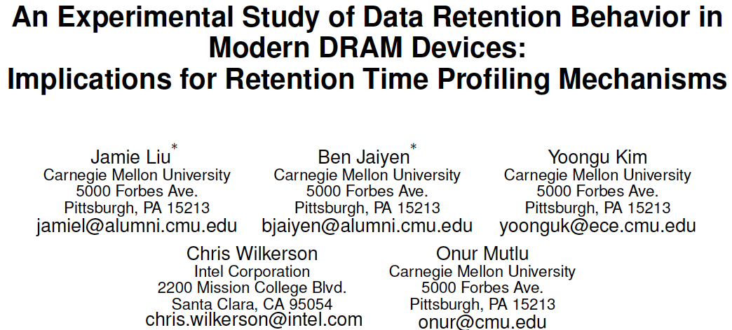
Analysis of Data Retention Failures [ISCA’13]
Jamie Liu, Ben Jaiyen, Yoongu Kim, Chris Wilkerson, and Onur Mutlu, "An Experimental Study of Data Retention Behavior in Modern DRAM Devices: Implications for Retention Time Profiling Mechanisms" Proceedings of the 40th International Symposium on Computer Architecture (ISCA), Tel-Aviv, Israel, June 2013. Slides (ppt) Slides (pdf)

Slide 86
Two Challenges to Retention Time Profiling
Data Pattern Dependence (DPD) of retention time
Variable Retention Time (VRT) phenomenon

Slide 87
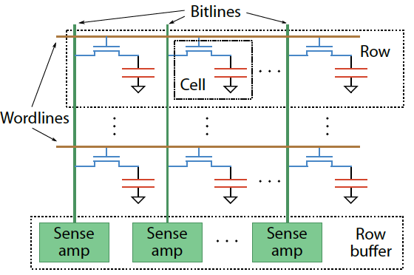
Two Challenges to Retention Time Profiling
Challenge 1: Data Pattern Dependence (DPD)
Retention time of a DRAM cell depends on its value and the values of cells nearby it
When a row is activated, all bitlines are perturbed simultaneously

Slide 88
Data Pattern Dependence
Electrical noise on the bitline affects reliable sensing of a DRAM cell
The magnitude of this noise is affected by values of nearby cells via
Bitline-bitline coupling → electrical coupling between adjacent bitlines
Bitline-wordline coupling → electrical coupling between each bitline and the activated wordline
Notes:
If a cell has lost enough charge, this noise can be large enough to cause a failure on a read
(normally, there is enough noise margin to tolerate the coupling noise)

Slide 89
Data Pattern Dependence
Electrical noise on the bitline affects reliable sensing of a DRAM cell
The magnitude of this noise is affected by values of nearby cells via
Bitline-bitline coupling → electrical coupling between adjacent bitlines
Bitline-wordline coupling → electrical coupling between each bitline and the activated wordline
Retention time of a cell depends on data patterns stored in nearby cells
→ need to find the worst data pattern to find worst-case retention time
→ this pattern is location dependent
Notes:
If a cell has lost enough charge, this noise can be large enough to cause a failure on a read
(normally, there is enough noise margin to tolerate the coupling noise)

Slide 90
Two Challenges to Retention Time Profiling
Challenge 2: Variable Retention Time (VRT)
Retention time of a DRAM cell changes randomly over time
a cell alternates between multiple retention time states
Leakage current of a cell changes sporadically due to a charge trap in the gate oxide of the DRAM cell access transistor
When the trap becomes occupied, charge leaks more readily from the transistor’s drain, leading to a short retention time
Called Trap-Assisted Gate-Induced Drain Leakage
This process appears to be a random process [Kim+ IEEE TED’11]
Worst-case retention time depends on a random process
→ need to find the worst case despite this

Slide 91
Modern DRAM Retention Time Distribution
NEWER
NEWER
OLDER
OLDER
Newer device families have more weak cells than older ones
Likely a result of technology scaling

Slide 92
An Example VRT Cell
A cell from E 2Gb chip family

Slide 93
Variable Retention Time
Many failing cells jump from
very high retention time to very low
Most failing cells
exhibit VRT
Min ret time = Max ret time
Expected if no VRT
A 2Gb chip family

Slide 94
More on Data Retention Failures [ISCA’13]
Jamie Liu, Ben Jaiyen, Yoongu Kim, Chris Wilkerson, and Onur Mutlu, "An Experimental Study of Data Retention Behavior in Modern DRAM Devices: Implications for Retention Time Profiling Mechanisms" Proceedings of the 40th International Symposium on Computer Architecture (ISCA), Tel-Aviv, Israel, June 2013. Slides (ppt) Slides (pdf)

Slide 95
Industry Is Writing Papers About It, Too

Slide 96
Industry Is Writing Papers About It, Too

Slide 97
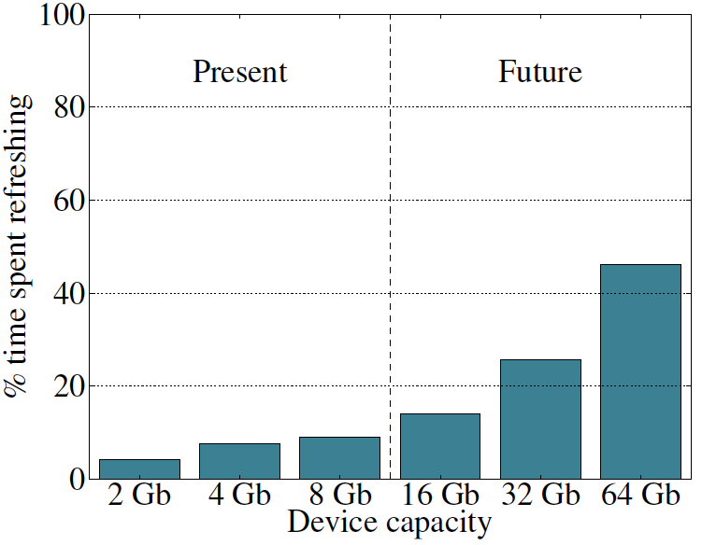
Refresh Overhead: Performance
46%
8%
Liu et al., “RAIDR: Retention-Aware Intelligent DRAM Refresh,” ISCA 2012.

Slide 98
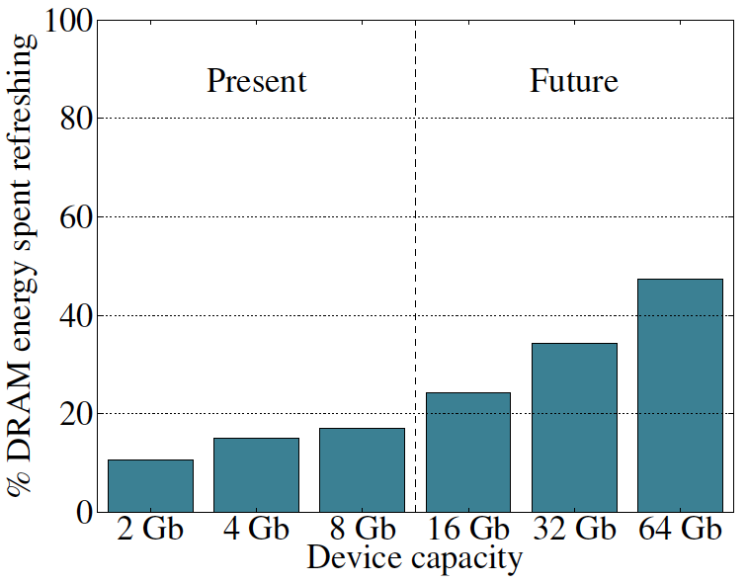
Refresh Overhead: Energy
47%
15%
Liu et al., “RAIDR: Retention-Aware Intelligent DRAM Refresh,” ISCA 2012.

Slide 99
Retention Time Profile of DRAM

Slide 100


RAIDR: Eliminating Unnecessary Refreshes
Observation: Most DRAM rows can be refreshed much less often without losing data [Kim+, EDL’09][Liu+ ISCA’13]
Key idea: Refresh rows containing weak cells
more frequently, other rows less frequently
1. Profiling: Profile retention time of all rows
2. Binning: Store rows into bins by retention time in memory controller
Efficient storage with Bloom Filters (only 1.25KB for 32GB memory)
3. Refreshing: Memory controller refreshes rows in different bins at different rates
Results: 8-core, 32GB, SPEC, TPC-C, TPC-H
74.6% refresh reduction @ 1.25KB storage
~16%/20% DRAM dynamic/idle power reduction
~9% performance improvement
Benefits increase with DRAM capacity
Liu et al., “RAIDR: Retention-Aware Intelligent DRAM Refresh,” ISCA 2012.

Slide 101

More on RAIDR: Perf+Energy Perspective
Jamie Liu, Ben Jaiyen, Richard Veras, and Onur Mutlu, "RAIDR: Retention-Aware Intelligent DRAM Refresh" Proceedings of the 39th International Symposium on Computer Architecture (ISCA), Portland, OR, June 2012. Slides (pdf)

Slide 102
Finding DRAM Retention Failures
How can we reliably find the retention time of all DRAM cells?
Goals: so that we can
Make DRAM reliable and secure
Make techniques like RAIDR work
→ improve performance and energy

Slide 103

Mitigation of Retention Issues [SIGMETRICS’14]
Samira Khan, Donghyuk Lee, Yoongu Kim, Alaa Alameldeen, Chris Wilkerson, and Onur Mutlu, "The Efficacy of Error Mitigation Techniques for DRAM Retention Failures: A Comparative Experimental Study" Proceedings of the ACM International Conference on Measurement and Modeling of Computer Systems (SIGMETRICS), Austin, TX, June 2014. [Slides (pptx) (pdf)] [Poster (pptx) (pdf)] [Full data sets]

Slide 104
Towards an Online Profiling System
Key Observations:
Testing alone cannot detect all possible failures
Combination of ECC and other mitigation techniques is much more effective
But degrades performance
Testing can help to reduce the ECC strength
Even when starting with a higher strength ECC
Khan+, “The Efficacy of Error Mitigation Techniques for DRAM Retention Failures: A Comparative Experimental Study,” SIGMETRICS 2014.
Notes:
Our high-level design for online profiling system is based to thee key observations:

Slide 105


Towards an Online Profiling System
Initially Protect DRAM
with Strong ECC
Periodically Test
Parts of DRAM
1
2
Test
ECC
Test
Test
Mitigate errors and
reduce ECC
3
Run tests periodically after a short interval
at smaller regions of memory
Notes:
Based on these observations, we propose that in an online profiling system,

Slide 106

Handling Variable Retention Time [DSN’15]
Moinuddin Qureshi, Dae Hyun Kim, Samira Khan, Prashant Nair, and Onur Mutlu, "AVATAR: A Variable-Retention-Time (VRT) Aware Refresh for DRAM Systems" Proceedings of the 45th Annual IEEE/IFIP International Conference on Dependable Systems and Networks (DSN), Rio de Janeiro, Brazil, June 2015. [Slides (pptx) (pdf)]

Slide 107
AVATAR
Insight: Avoid retention failures ➔ Upgrade row on ECC error
Observation: Rate of VRT >> Rate of soft error (50x-2500x)
Scrub
(15 min)
DRAM Rows
Ref. Rate Table
ECC
A
0
ECC
B
Weak Cell
0
ECC
C
1
ECC
D
RETENTION
PROFILING
0
Row protected from future
retention failures
ECC
E
0
ECC
F
0
ECC
G
1
1
ECC
H
0
AVATAR mitigates VRT by increasing refresh rate on error

Slide 108

RESULTS: REFRESH SAVINGS
Retention Testing Once a Year can revert refresh saving from 60% to 70%
No VRT
AVATAR
AVATAR reduces refresh by 60%-70%, similar to multi rate refresh but with VRT tolerance

Slide 109
SPEEDUP
Speedup
AVATAR gets 2/3rd the performance of NoRefresh. More gains at higher capacity nodes

Slide 110
ENERGY DELAY PRODUCT
Energy Delay Product
AVATAR reduces EDP,
Significant reduction at higher capacity nodes

Slide 111

Handling Data-Dependent Failures [DSN’16]
Samira Khan, Donghyuk Lee, and Onur Mutlu, "PARBOR: An Efficient System-Level Technique to Detect Data-Dependent Failures in DRAM" Proceedings of the 45th Annual IEEE/IFIP International Conference on Dependable Systems and Networks (DSN), Toulouse, France, June 2016. [Slides (pptx) (pdf)]

Slide 112
Handling Data-Dependent Failures [MICRO’17]
Samira Khan, Chris Wilkerson, Zhe Wang, Alaa R. Alameldeen, Donghyuk Lee, and Onur Mutlu, "Detecting and Mitigating Data-Dependent DRAM Failures by Exploiting Current Memory Content" Proceedings of the 50th International Symposium on Microarchitecture (MICRO), Boston, MA, USA, October 2017. [Slides (pptx) (pdf)] [Lightning Session Slides (pptx) (pdf)] [Poster (pptx) (pdf)]

Slide 113

Handling Both DPD and VRT [ISCA’17]
Minesh Patel, Jeremie S. Kim, and Onur Mutlu, "The Reach Profiler (REAPER): Enabling the Mitigation of DRAM Retention Failures via Profiling at Aggressive Conditions" Proceedings of the 44th International Symposium on Computer Architecture (ISCA), Toronto, Canada, June 2017. [Slides (pptx) (pdf)] [Lightning Session Slides (pptx) (pdf)]
First experimental analysis of (mobile) LPDDR4 chips
Analyzes the complex tradeoff space of retention time profiling
Idea: enable fast and robust profiling at higher refresh intervals & temperatures

Slide 114




The Reach Profiler (REAPER): Enabling the Mitigation of DRAM Retention Failures via Profiling at Aggressive Conditions
Minesh Patel Jeremie S. Kim
Onur Mutlu
Notes:
Hi, I’m Minesh Patel from ETH Zurich
and today, I’ll talk about the reach profiler, a new methodology for DRAM retention failure profiling

Slide 115

Leaky
DRAM
Row Decoder
SA
SA
SA
SA
SA
Notes:
DRAM is composed of a heterogeneous set of cells with various different leakage rates

Slide 116
Leaky Cells
Periodic DRAM Refresh
Performance + Energy Overhead
Notes:
This requires a process called DRAM refresh in order to periodically restore charge to the leaky cells
However, this results in significant system performance and energy penalties.

Slide 117
Goal: find all retention failures for
a refresh interval T > default (64ms)
Row Decoder
SA
SA
SA
SA
SA
Notes:
Ideally, we would like to identify all the cells that fail at a given refresh interval so that we can extend the default refresh interval past 64ms and mitigate DRAM refresh overhead

Slide 118
Process, voltage, temperature
Variable retention time
Data pattern dependence
Notes:
However, there are a number of unwanted effects that complicate profiling, which I will go into in detail in my talk later this afternoon

Slide 119
Characterization of
368 LPDDR4 DRAM Chips
1
Cells are more likely to fail at an
increased (refresh interval | temperature)
2
Complex tradeoff space between profiling
(speed & coverage & false positives)
Notes:
In order to better understand these effects in modern DRAM, we perform the first extensive characterization of 368 LPDDR4 DRAM chips
We make two major observations
First, we find that cells are more likely to fail at an increased refresh interval or temperature
Second, we identify a complex tradeoff space surrounding profiling, and characterize it in terms of profiling speed, failure coverage, and false positive rate

Slide 120
temperature
operate
here
refresh interval
Notes:
We leverage these observations to develop the reach profiler, which searches for failures NOT at the operating conditions,

Slide 121
REACH
PROFILING
profile
here
temperature
operate
here
refresh interval
Notes:
But rather at reach conditions, where cells are more likely to fail

Slide 122
Reach Profiling
A new DRAM retention failure profiling methodology
+ Faster and more reliable
than current approaches
+ Enables longer refresh intervals
Notes:
We find that this not only increases profiling speed and reliability beyond prior approaches to profiling,
But also enables longer refresh intervals that were previously unreasonable due to profiling overhead

Slide 123
REAPER Outline
1. DRAM Refresh Background
2. Failure Profiling Challenges
3. Current Approaches
4. LPDDR4 Characterization
5. Reach Profiling
6. End-to-end Evaluation
18/36
Notes:
To this end, we perform an extensive characterization of LPDDR4 DRAM chips
[END]

Slide 124
Experimental Infrastructure
368 2y-nm LPDDR4 DRAM chips
4Gb chip size
From 3 major DRAM vendors
Thermally controlled testing chamber
Ambient temperature range: {40°C – 55°C} ± 0.25°C
DRAM temperature is held at 15°C above ambient
19/36
Notes:
The infrastructure we developed can test 368 state-of-the-art LPDDR4 DRAM chips.
Each chip is 4 gigaBITS in size, and we have chips from across three major DRAM vendors.
[CLICK]
We test within a thermally controlled chamber with an ambient temperature range of 40 to 55 degrees C with a tolerance of 0.25 degrees.
DRAM temperature is always held at 15 degrees C above ambient using a local heat source
[END]

Slide 125
LPDDR4 Studies
Temperature
Data Pattern Dependence
Retention Time Distributions
Variable Retention Time
Individual Cell Characterization
20/36
Notes:
Here are the studies that we did using our infrastructure.
We find that the first three, temperature, data pattern dependence, and retention time distributions, show results similar to those in prior work using DDR3 DRAM.
[CLICK]
Therefore, in this talk I’m going to focus on 4 and 5, variable retention time, and individual cell characterization, which show new results that help motivate our mechanism.
[END]

Slide 126

Long-term Continuous Profiling
Representative chip from Vendor B, 2048ms, 45°C
# New Failing Cells
Time (days)
New failing cells continue to appear over time
Attributed to variable retention time (VRT)
The set of failing cells changes over time
21/36
Notes:
Here is some data we collected from a representative chip at a fixed refresh interval of 2048ms.
We show the number of new failing cells discovered by continuously profiling over 6 days.
[CLICK]
We see that new failing cells continue to appear over time.
We attribute these to variable retention time effects, which mean that cells can randomly change retention times at any point.
[CLICK]
This shows that the set of failing cells we find at 2048ms changes over time
[CLICK]
This means that error correction codes and online profiling are necessary to manage new failing cells that continue to appear
[END]

Slide 127
Long-term Continuous Profiling
Representative chip from Vendor B, 2048ms, 45°C
# New Failing Cells
Error correction codes (ECC)
and online profiling are necessary
to manage new failing cells
Time (days)
New failing cells continue to appear over time
Attributed to variable retention time (VRT)
The set of failing cells changes over time
21/36
Notes:
Here is some data we collected from a representative chip at a fixed refresh interval of 2048ms.
We show the number of new failing cells discovered by continuously profiling over 6 days.
[CLICK]
We see that new failing cells continue to appear over time.
We attribute these to variable retention time effects, which mean that cells can randomly change retention times at any point.
[CLICK]
This shows that the set of failing cells we find at 2048ms changes over time
[CLICK]
This means that error correction codes and online profiling are necessary to manage new failing cells that continue to appear
[END]

Slide 128
Single-cell Failure Probability (Cartoon)
idealized cell
(retention time = 3s)
22/36
Notes:
In another study, we analyzed the failure probability of individual cells.
Here we show the probability of read failure for a single cell over different refresh intervals
We show an idealized cell, with never fails below 3.5 seconds, but always fails above 3.5s
We can say that this cell has a retention time of 3.5s.
[CLICK]
However, we find that real cells look more like the blue cartoon, which follows a normal distribution with a mean at 3.5s.
Note that even below 3.5s, there is a nonzero probability of the cell failing.
[END]

Slide 129
Single-cell Failure Probability (Cartoon)
idealized cell
(retention time = 3s)
actual cell
N(μ, σ) | μ = 3s
22/36
Notes:
In another study, we analyzed the failure probability of individual cells.
Here we show the probability of read failure for a single cell over different refresh intervals
We show an idealized cell, with never fails below 3.5 seconds, but always fails above 3.5s
We can say that this cell has a retention time of 3.5s.
[CLICK]
However, we find that real cells look more like the blue cartoon, which follows a normal distribution with a mean at 3.5s.
Note that even below 3.5s, there is a nonzero probability of the cell failing.
[END]

Slide 130
Single-cell Failure Probability (Real)
22/36
Notes:
TEMPERATURE TEMPERATURE TEMPERATURE TEMPERATURE TEMPERATURE TEMPERATURE TEMPERATURE
Here we show real data from a real chip, [CLICK] which we collected by testing how often the cell failed out of 16 trials for different refresh intervals.
[CLICK]
We now show 8 different cells from the same chip.
[CLICK]
Suppose we are interested in operating at a refresh interval of 1.7 seconds.
[CLICK]
We will find 6 cells with a non-negligible probability of failing
[CLICK]
However, the bottom two cells will be hard to find since they have a low probability of failure at this refresh interval
[CLICK]
Instead, if we profile at an increased refresh interval, [CLICK] the same cells will be much easier to find since they will have a high probability of failure.
[CLICK]
However, we will also identify some additional cells as failing, which can end up being false positives.
[CLICK]
We repeat the same analysis for temperature variation and find that cells behave similarly. We show details of this analysis in the paper.
[CLICK]
The takeaway here is that any given cell is more likely to fail at a longer refresh interval or a higher temperature.
[END]

Slide 131
Single-cell Failure Probability (Real)
failed 9 times out of 16 trials
22/36
Notes:
TEMPERATURE TEMPERATURE TEMPERATURE TEMPERATURE TEMPERATURE TEMPERATURE TEMPERATURE
Here we show real data from a real chip, [CLICK] which we collected by testing how often the cell failed out of 16 trials for different refresh intervals.
[CLICK]
We now show 8 different cells from the same chip.
[CLICK]
Suppose we are interested in operating at a refresh interval of 1.7 seconds.
[CLICK]
We will find 6 cells with a non-negligible probability of failing
[CLICK]
However, the bottom two cells will be hard to find since they have a low probability of failure at this refresh interval
[CLICK]
Instead, if we profile at an increased refresh interval, [CLICK] the same cells will be much easier to find since they will have a high probability of failure.
[CLICK]
However, we will also identify some additional cells as failing, which can end up being false positives.
[CLICK]
We repeat the same analysis for temperature variation and find that cells behave similarly. We show details of this analysis in the paper.
[CLICK]
The takeaway here is that any given cell is more likely to fail at a longer refresh interval or a higher temperature.
[END]

Slide 132
Single-cell Failure Probability (Real)
22/36
Notes:
TEMPERATURE TEMPERATURE TEMPERATURE TEMPERATURE TEMPERATURE TEMPERATURE TEMPERATURE
Here we show real data from a real chip, [CLICK] which we collected by testing how often the cell failed out of 16 trials for different refresh intervals.
[CLICK]
We now show 8 different cells from the same chip.
[CLICK]
Suppose we are interested in operating at a refresh interval of 1.7 seconds.
[CLICK]
We will find 6 cells with a non-negligible probability of failing
[CLICK]
However, the bottom two cells will be hard to find since they have a low probability of failure at this refresh interval
[CLICK]
Instead, if we profile at an increased refresh interval, [CLICK] the same cells will be much easier to find since they will have a high probability of failure.
[CLICK]
However, we will also identify some additional cells as failing, which can end up being false positives.
[CLICK]
We repeat the same analysis for temperature variation and find that cells behave similarly. We show details of this analysis in the paper.
[CLICK]
The takeaway here is that any given cell is more likely to fail at a longer refresh interval or a higher temperature.
[END]

Slide 133
Single-cell Failure Probability (Real)
22/36
Notes:
TEMPERATURE TEMPERATURE TEMPERATURE TEMPERATURE TEMPERATURE TEMPERATURE TEMPERATURE
Here we show real data from a real chip, [CLICK] which we collected by testing how often the cell failed out of 16 trials for different refresh intervals.
[CLICK]
We now show 8 different cells from the same chip.
[CLICK]
Suppose we are interested in operating at a refresh interval of 1.7 seconds.
[CLICK]
We will find 6 cells with a non-negligible probability of failing
[CLICK]
However, the bottom two cells will be hard to find since they have a low probability of failure at this refresh interval
[CLICK]
Instead, if we profile at an increased refresh interval, [CLICK] the same cells will be much easier to find since they will have a high probability of failure.
[CLICK]
However, we will also identify some additional cells as failing, which can end up being false positives.
[CLICK]
We repeat the same analysis for temperature variation and find that cells behave similarly. We show details of this analysis in the paper.
[CLICK]
The takeaway here is that any given cell is more likely to fail at a longer refresh interval or a higher temperature.
[END]

Slide 134
Single-cell Failure Probability (Real)
operate here
22/36
Notes:
TEMPERATURE TEMPERATURE TEMPERATURE TEMPERATURE TEMPERATURE TEMPERATURE TEMPERATURE
Here we show real data from a real chip, [CLICK] which we collected by testing how often the cell failed out of 16 trials for different refresh intervals.
[CLICK]
We now show 8 different cells from the same chip.
[CLICK]
Suppose we are interested in operating at a refresh interval of 1.7 seconds.
[CLICK]
We will find 6 cells with a non-negligible probability of failing
[CLICK]
However, the bottom two cells will be hard to find since they have a low probability of failure at this refresh interval
[CLICK]
Instead, if we profile at an increased refresh interval, [CLICK] the same cells will be much easier to find since they will have a high probability of failure.
[CLICK]
However, we will also identify some additional cells as failing, which can end up being false positives.
[CLICK]
We repeat the same analysis for temperature variation and find that cells behave similarly. We show details of this analysis in the paper.
[CLICK]
The takeaway here is that any given cell is more likely to fail at a longer refresh interval or a higher temperature.
[END]

Slide 135
Single-cell Failure Probability (Real)
operate here
22/36
Notes:
TEMPERATURE TEMPERATURE TEMPERATURE TEMPERATURE TEMPERATURE TEMPERATURE TEMPERATURE
Here we show real data from a real chip, [CLICK] which we collected by testing how often the cell failed out of 16 trials for different refresh intervals.
[CLICK]
We now show 8 different cells from the same chip.
[CLICK]
Suppose we are interested in operating at a refresh interval of 1.7 seconds.
[CLICK]
We will find 6 cells with a non-negligible probability of failing
[CLICK]
However, the bottom two cells will be hard to find since they have a low probability of failure at this refresh interval
[CLICK]
Instead, if we profile at an increased refresh interval, [CLICK] the same cells will be much easier to find since they will have a high probability of failure.
[CLICK]
However, we will also identify some additional cells as failing, which can end up being false positives.
[CLICK]
We repeat the same analysis for temperature variation and find that cells behave similarly. We show details of this analysis in the paper.
[CLICK]
The takeaway here is that any given cell is more likely to fail at a longer refresh interval or a higher temperature.
[END]

Slide 136
Single-cell Failure Probability (Real)
operate here
hard
to find
22/36
Notes:
TEMPERATURE TEMPERATURE TEMPERATURE TEMPERATURE TEMPERATURE TEMPERATURE TEMPERATURE
Here we show real data from a real chip, [CLICK] which we collected by testing how often the cell failed out of 16 trials for different refresh intervals.
[CLICK]
We now show 8 different cells from the same chip.
[CLICK]
Suppose we are interested in operating at a refresh interval of 1.7 seconds.
[CLICK]
We will find 6 cells with a non-negligible probability of failing
[CLICK]
However, the bottom two cells will be hard to find since they have a low probability of failure at this refresh interval
[CLICK]
Instead, if we profile at an increased refresh interval, [CLICK] the same cells will be much easier to find since they will have a high probability of failure.
[CLICK]
However, we will also identify some additional cells as failing, which can end up being false positives.
[CLICK]
We repeat the same analysis for temperature variation and find that cells behave similarly. We show details of this analysis in the paper.
[CLICK]
The takeaway here is that any given cell is more likely to fail at a longer refresh interval or a higher temperature.
[END]

Slide 137
Single-cell Failure Probability (Real)
operate here
profile here
hard
to find
22/36
Notes:
TEMPERATURE TEMPERATURE TEMPERATURE TEMPERATURE TEMPERATURE TEMPERATURE TEMPERATURE
Here we show real data from a real chip, [CLICK] which we collected by testing how often the cell failed out of 16 trials for different refresh intervals.
[CLICK]
We now show 8 different cells from the same chip.
[CLICK]
Suppose we are interested in operating at a refresh interval of 1.7 seconds.
[CLICK]
We will find 6 cells with a non-negligible probability of failing
[CLICK]
However, the bottom two cells will be hard to find since they have a low probability of failure at this refresh interval
[CLICK]
Instead, if we profile at an increased refresh interval, [CLICK] the same cells will be much easier to find since they will have a high probability of failure.
[CLICK]
However, we will also identify some additional cells as failing, which can end up being false positives.
[CLICK]
We repeat the same analysis for temperature variation and find that cells behave similarly. We show details of this analysis in the paper.
[CLICK]
The takeaway here is that any given cell is more likely to fail at a longer refresh interval or a higher temperature.
[END]

Slide 138
Single-cell Failure Probability (Real)
operate here
profile here
easy
to find
hard
to find
22/36
Notes:
TEMPERATURE TEMPERATURE TEMPERATURE TEMPERATURE TEMPERATURE TEMPERATURE TEMPERATURE
Here we show real data from a real chip, [CLICK] which we collected by testing how often the cell failed out of 16 trials for different refresh intervals.
[CLICK]
We now show 8 different cells from the same chip.
[CLICK]
Suppose we are interested in operating at a refresh interval of 1.7 seconds.
[CLICK]
We will find 6 cells with a non-negligible probability of failing
[CLICK]
However, the bottom two cells will be hard to find since they have a low probability of failure at this refresh interval
[CLICK]
Instead, if we profile at an increased refresh interval, [CLICK] the same cells will be much easier to find since they will have a high probability of failure.
[CLICK]
However, we will also identify some additional cells as failing, which can end up being false positives.
[CLICK]
We repeat the same analysis for temperature variation and find that cells behave similarly. We show details of this analysis in the paper.
[CLICK]
The takeaway here is that any given cell is more likely to fail at a longer refresh interval or a higher temperature.
[END]

Slide 139
Single-cell Failure Probability (Real)
operate here
profile here
easy
to find
hard
false
to find
positives
22/36
Notes:
TEMPERATURE TEMPERATURE TEMPERATURE TEMPERATURE TEMPERATURE TEMPERATURE TEMPERATURE
Here we show real data from a real chip, [CLICK] which we collected by testing how often the cell failed out of 16 trials for different refresh intervals.
[CLICK]
We now show 8 different cells from the same chip.
[CLICK]
Suppose we are interested in operating at a refresh interval of 1.7 seconds.
[CLICK]
We will find 6 cells with a non-negligible probability of failing
[CLICK]
However, the bottom two cells will be hard to find since they have a low probability of failure at this refresh interval
[CLICK]
Instead, if we profile at an increased refresh interval, [CLICK] the same cells will be much easier to find since they will have a high probability of failure.
[CLICK]
However, we will also identify some additional cells as failing, which can end up being false positives.
[CLICK]
We repeat the same analysis for temperature variation and find that cells behave similarly. We show details of this analysis in the paper.
[CLICK]
The takeaway here is that any given cell is more likely to fail at a longer refresh interval or a higher temperature.
[END]

Slide 140
Single-cell Failure Probability (Real)
operate here
profile here
easy
Any cell is more likely to fail
at a longer refresh interval
OR a higher temperature
to find
hard
false
to find
positives
22/36
Notes:
TEMPERATURE TEMPERATURE TEMPERATURE TEMPERATURE TEMPERATURE TEMPERATURE TEMPERATURE
Here we show real data from a real chip, [CLICK] which we collected by testing how often the cell failed out of 16 trials for different refresh intervals.
[CLICK]
We now show 8 different cells from the same chip.
[CLICK]
Suppose we are interested in operating at a refresh interval of 1.7 seconds.
[CLICK]
We will find 6 cells with a non-negligible probability of failing
[CLICK]
However, the bottom two cells will be hard to find since they have a low probability of failure at this refresh interval
[CLICK]
Instead, if we profile at an increased refresh interval, [CLICK] the same cells will be much easier to find since they will have a high probability of failure.
[CLICK]
However, we will also identify some additional cells as failing, which can end up being false positives.
[CLICK]
We repeat the same analysis for temperature variation and find that cells behave similarly. We show details of this analysis in the paper.
[CLICK]
The takeaway here is that any given cell is more likely to fail at a longer refresh interval or a higher temperature.
[END]

Slide 141
REAPER Outline
1. DRAM Refresh Background
2. Failure Profiling Challenges
3. Current Approaches
4. LPDDR4 Characterization
5. Reach Profiling
6. End-to-end Evaluation
23/36
Notes:
This leads us into the key idea of reach profiling
[END]

Slide 142
Reach Profiling
Key idea: profile at a longer refresh interval and/or a higher temperature
temperature
operate
here
refresh interval
24/36
Notes:
…which is to profile NOT at the desired operating conditions, but rather at a longer refresh interval and/or a higher tempereature
[CLICK]
The pros of this approach are that it’s faster and more reliable since we are profiling for failures where they are most likely to occur
[CLICK]
However, we may also identify false positives, which fail under profiling conditions but not under operating conditions
[END]

Slide 143
Reach Profiling
Key idea: profile at a longer refresh interval and/or a higher temperature
profile
here
temperature
operate
here
refresh interval
24/36
Notes:
…which is to profile NOT at the desired operating conditions, but rather at a longer refresh interval and/or a higher tempereature
[CLICK]
The pros of this approach are that it’s faster and more reliable since we are profiling for failures where they are most likely to occur
[CLICK]
However, we may also identify false positives, which fail under profiling conditions but not under operating conditions
[END]

Slide 144
Reach Profiling
Key idea: profile at a longer refresh interval and/or a higher temperature
Pros
Fast + Reliable: reach profiling searches for cells where they are most likely to fail
Cons
False Positives: profiler may identify cells that fail under profiling conditions, but not under operating conditions
25/36
Notes:
…which is to profile NOT at the desired operating conditions, but rather at a longer refresh interval and/or a higher tempereature
[CLICK]
The pros of this approach are that it’s faster and more reliable since we are profiling for failures where they are most likely to occur
[CLICK]
However, we may also identify false positives, which fail under profiling conditions but not under operating conditions
[END]

Slide 145
Towards an Implementation
Reach profiling is a general methodology
3 key questions for an implementation:
What are desirable profiling conditions?
How often should the system profile?
What information does the profiler need?
26/36
Notes:
Reach profiling as shown is a general methodology.
[CLICK]
In order to turn it into a concrete implementation, we need to answer three key questions
[CLICK]
First, what are the desirable profiling conditions?
[CLICK]
Second, how often must we reprofile?
[CLICK]
Third, what information does the profiler need in order to figure all of this out?
[END]

Slide 146
Three Key Profiling Metrics
Runtime: how long profiling takes
Coverage: portion of all possible failures discovered by profiling
False positives: number of cells observed to fail during profiling but never during actual operation
27/36
Notes:
To this end, we identify three key metrics we can use to characterize any retention failure profiling mechanism.
[CLICK]
Runtime represents how long profiling actually takes
[CLICK]
Coverage represents the portion of all possible failures that are discovered by the profiling mechanism
[CLICK]
False positives represent the number of cells that are observed to fail during profiling, but never during actual operation
[CLICK]
We then perform a detailed exploration of how these three metrics change under many different profiling conditions.
[END]

Slide 147
Three Key Profiling Metrics
Runtime: how long profiling takes
Coverage: portion of all possible failures discovered by profiling
False positives: number of cells observed to fail during profiling but never during actual operation
We explore how these three metrics
change under many different
profiling conditions
27/36
Notes:
To this end, we identify three key metrics we can use to characterize any retention failure profiling mechanism.
[CLICK]
Runtime represents how long profiling actually takes
[CLICK]
Coverage represents the portion of all possible failures that are discovered by the profiling mechanism
[CLICK]
False positives represent the number of cells that are observed to fail during profiling, but never during actual operation
[CLICK]
We then perform a detailed exploration of how these three metrics change under many different profiling conditions.
[END]

Slide 148
Evaluation Methodology
Simulators
Performance: Ramulator [Kim+, CAL’15]
Energy: DRAMPower [Chandrasekar+, DSD’11]
Configuration
4-core (4GHz), 8MB LLC
LPDDR4-3200, 4 channels, 1 rank/channel
Workloads
20 random 4-core benchmark mixes
SPEC CPU2006 benchmark suite
33/36
Notes:
We evaluate REAPER using Ramulator for performance and DRAMPower for DRAM energy.
We model a 4-core system using 4 channels of LPDDR4 DRAM
[CLICK]
We measure performance and energy across 20 random 4-core benchmark mixes drawn from the SPEC CPU2006 benchmark suite
[END]

Slide 149



Simulated End-to-end Performance
refresh interval (ms)
34/36
Notes:
Here is a plot of our simulated end-to-end performance gain for operating at different refresh intervals.
The boxplots show the distribution of benchmark performance for brute-force profiling, REAPER, and the ideal profiling mechanism with no overhead.
[CLICK]
We see that for short refresh intervals, where we reprofile rarely, profiling overhead is not significant and both profiling mechanisms come close to ideal.
[CLICK]
However, for long refresh intervals where we reprofile often, profiling overhead is highly significant and actually begins to cause system performance degradation.
[CLICK]
We see that at 1024 and 1280 milliseconds, visibly REAPER outperforms brute-force profiling, maintaining more of the ideal profiler’s benefit than brute-force profiling is able to.
[CLICK]
Overall, we find that REAPER enables a best-case 16.3% system performance improvement and a 36.4% DRAM power reduction, which is shown in the paper.
[CLICK]
Furthermore, REAPER enables the 1280ms refresh interval, which is unreasonable with brute-force profiling due to profiling overhead.
[END]

Slide 150
Simulated End-to-end Performance
refresh interval (ms)
Reprofile rarely
Reprofile often
34/36
Notes:
Here is a plot of our simulated end-to-end performance gain for operating at different refresh intervals.
The boxplots show the distribution of benchmark performance for brute-force profiling, REAPER, and the ideal profiling mechanism with no overhead.
[CLICK]
We see that for short refresh intervals, where we reprofile rarely, profiling overhead is not significant and both profiling mechanisms come close to ideal.
[CLICK]
However, for long refresh intervals where we reprofile often, profiling overhead is highly significant and actually begins to cause system performance degradation.
[CLICK]
We see that at 1024 and 1280 milliseconds, visibly REAPER outperforms brute-force profiling, maintaining more of the ideal profiler’s benefit than brute-force profiling is able to.
[CLICK]
Overall, we find that REAPER enables a best-case 16.3% system performance improvement and a 36.4% DRAM power reduction, which is shown in the paper.
[CLICK]
Furthermore, REAPER enables the 1280ms refresh interval, which is unreasonable with brute-force profiling due to profiling overhead.
[END]

Slide 151
Simulated End-to-end Performance
refresh interval (ms)
Reprofile rarely
Reprofile often
34/36
Notes:
Here is a plot of our simulated end-to-end performance gain for operating at different refresh intervals.
The boxplots show the distribution of benchmark performance for brute-force profiling, REAPER, and the ideal profiling mechanism with no overhead.
[CLICK]
We see that for short refresh intervals, where we reprofile rarely, profiling overhead is not significant and both profiling mechanisms come close to ideal.
[CLICK]
However, for long refresh intervals where we reprofile often, profiling overhead is highly significant and actually begins to cause system performance degradation.
[CLICK]
We see that at 1024 and 1280 milliseconds, visibly REAPER outperforms brute-force profiling, maintaining more of the ideal profiler’s benefit than brute-force profiling is able to.
[CLICK]
Overall, we find that REAPER enables a best-case 16.3% system performance improvement and a 36.4% DRAM power reduction, which is shown in the paper.
[CLICK]
Furthermore, REAPER enables the 1280ms refresh interval, which is unreasonable with brute-force profiling due to profiling overhead.
[END]

Slide 152
Simulated End-to-end Performance
On average, REAPER enables:
16.3% system performance improvement
36.4% DRAM power reduction
REAPER enables longer refresh intervals, which are unreasonable
using brute-force profiling
refresh interval (ms)
Reprofile rarely
Reprofile often
34/36
Notes:
Here is a plot of our simulated end-to-end performance gain for operating at different refresh intervals.
The boxplots show the distribution of benchmark performance for brute-force profiling, REAPER, and the ideal profiling mechanism with no overhead.
[CLICK]
We see that for short refresh intervals, where we reprofile rarely, profiling overhead is not significant and both profiling mechanisms come close to ideal.
[CLICK]
However, for long refresh intervals where we reprofile often, profiling overhead is highly significant and actually begins to cause system performance degradation.
[CLICK]
We see that at 1024 and 1280 milliseconds, visibly REAPER outperforms brute-force profiling, maintaining more of the ideal profiler’s benefit than brute-force profiling is able to.
[CLICK]
Overall, we find that REAPER enables a best-case 16.3% system performance improvement and a 36.4% DRAM power reduction, which is shown in the paper.
[CLICK]
Furthermore, REAPER enables the 1280ms refresh interval, which is unreasonable with brute-force profiling due to profiling overhead.
[END]

Slide 153
Other Analyses in the Paper
Detailed LPDDR4 characterization data
Temperature dependence effects
Retention time distributions
Data pattern dependence
Variable retention time
Individual cell failure distributions
Profiling tradeoff space characterization
Runtime, coverage, and false positive rate
Temperature and refresh interval
Probabilistic model for tolerable failure rates
Detailed results for end-to-end evaluations
35/36
Notes:
The paper contains many other analyses that we didn’t have time to cover here today.
[CLICK]
These include a much more detailed characterization of LPDDR4 DRAM chips, including results and takeaways
[CLICK]
A much more in-depth analysis of the tradeoff space surrounding profiling
[CLICK]
A detailed analysis of the probabilistic model we use to compute how often we need to reprofile
[CLICK]
And detailed results for our end-to-end evaluations, including both performance and energy
[END]

Slide 154
REAPER Summary
Problem:
DRAM refresh performance and energy overhead is high
Current approaches to retention failure profiling are slow or unreliable
Goals:
Thoroughly analyze profiling tradeoffs
Develop a fast and reliable profiling mechanism
Key Contributions:
First detailed characterization of 368 LPDDR4 DRAM chips
Reach profiling: Profile at a longer refresh interval or higher temperature than target conditions, where cells are more likely to fail
Evaluation:
2.5x faster profiling with 99% coverage and 50% false positives
REAPER enables 16.3% system performance improvement and 36.4% DRAM power reduction
Enables longer refresh intervals that were previously unreasonable
36/36
Notes:
To conclude, I’ll go over a summary of the talk.
The high level motivation for this work is that DRAM refresh is a major impediment to scaling, especially in terms of energy.
The specific problem that we focus on is that DRAM retention failure profiling is hard.
Our goals in this work are twofold. First, we would like to thoroughly analyze retention failure profiling tradeoffs
Second, we would like to use what we learn to develop a fast, reliable profiling mechanism.
We make two key contributions in this work.
First, we perform the first detailed retention failure characterization of 368 LPDDR4 DRAM chips
Second, we use what we learn to introduce the reach profiler, which profiles for failures at a longer refresh interval and/or a higher temperature, where cells are more likely to fail.
Through our evaluations, we find that reach profiling increases profiling performance by an average of 2.5x while maintaining high coverage and a moderate false positive rate.
Our implementation of reach profiling, called REAPER, enables significant system performance improvement and DRAM power reduction.
Finally, reach profiling enables longer refresh intervals that were previously unreasonable due to profiling overhead.
[END]

Slide 155
Handling Both DPD and VRT [ISCA’17]
Minesh Patel, Jeremie S. Kim, and Onur Mutlu, "The Reach Profiler (REAPER): Enabling the Mitigation of DRAM Retention Failures via Profiling at Aggressive Conditions" Proceedings of the 44th International Symposium on Computer Architecture (ISCA), Toronto, Canada, June 2017. [Slides (pptx) (pdf)] [Lightning Session Slides (pptx) (pdf)]
First experimental analysis of (mobile) LPDDR4 chips
Analyzes the complex tradeoff space of retention time profiling
Idea: enable fast and robust profiling at higher refresh intervals & temperatures

Slide 156


The DRAM Latency PUF: Quickly Evaluating Physical Unclonable Functions by Exploiting the Latency-Reliability Tradeoff in Modern Commodity DRAM Devices
Jeremie S. Kim Minesh Patel
Hasan Hassan Onur Mutlu
HPCA 2018
QR Code for the paper
https://people.inf.ethz.ch/omutlu/pub/dram-latency-puf_hpca18.pdf
Notes:
Please come to my talk at HPCA 2018, if you would like to learn more or have any questions. Thank you very much.

Slide 157
Keeping Future Memory Secure

Slide 158
How Do We Keep Memory Secure?
DRAM
Flash memory
Emerging Technologies
Phase Change Memory
STT-MRAM
RRAM, memristors
…

Slide 159
Solution Direction: Principled Designs
Design fundamentally secure
computing architectures
Predict and prevent
such safety issues

Slide 160
Recall: Collapse of the “Galloping Gertie”
Source: AP
http://www.wsdot.wa.gov/tnbhistory/connections/connections3.htm

Slide 161

Another Example (1994)
Source: By 최광모 - Own work, CC BY-SA 4.0, https://commons.wikimedia.org/w/index.php?curid=35197984

Slide 162

Yet Another Example (2007)
Source: Morry Gash/AP,
https://www.npr.org/2017/08/01/540669701/10-years-after-bridge-collapse-america-is-still-crumbling?t=1535427165809

Slide 163

A More Recent Example (2018)
Source: AFP / Valery HACHE, https://www.capitalfm.co.ke/news/2018/08/genoa-bridge-collapse-what-we-know/

Slide 164
Architecting for Security
Understand: Methods for vulnerability modeling & discovery
Modeling and prediction based on real (device) data and analysis
Understanding vulnerabilities
Developing reliable metrics
Architect: Principled architectures with security as key concern
Good partitioning of duties across the stack
Cannot give up performance and efficiency
Patch-ability in the field
Design & Test: Principled design, automation, (online) testing
Design for security
High coverage and good interaction with system reliability methods

Slide 165
Understand and Model with Experiments (DRAM)
Temperature
Controller
FPGAs
Heater
FPGAs
PC
Kim+, “Flipping Bits in Memory Without Accessing Them: An Experimental Study of DRAM Disturbance Errors,” ISCA 2014.

Slide 166
Understand and Model with Experiments (Flash)
USB Daughter Board
USB Jack
HAPS-52 Mother Board
Virtex-II Pro
(USB controller)
1x-nm
NAND Flash
Virtex-V FPGA
(NAND Controller)
[DATE 2012, ICCD 2012, DATE 2013, ITJ 2013, ICCD 2013, SIGMETRICS 2014, HPCA 2015, DSN 2015, MSST 2015, JSAC 2016, HPCA 2017, DFRWS 2017,
PIEEE 2017, HPCA 2018, SIGMETRICS 2018]
NAND Daughter Board
Cai+, “Error Characterization, Mitigation, and Recovery in Flash Memory Based Solid State Drives,” Proc. IEEE 2017.

Slide 167
Understanding Flash Memory Reliability
Proceedings of the IEEE, Sept. 2017
https://arxiv.org/pdf/1706.08642

Slide 168

Understanding Flash Memory Reliability
Justin Meza, Qiang Wu, Sanjeev Kumar, and Onur Mutlu, "A Large-Scale Study of Flash Memory Errors in the Field" Proceedings of the ACM International Conference on Measurement and Modeling of Computer Systems (SIGMETRICS), Portland, OR, June 2015. [Slides (pptx) (pdf)] [Coverage at ZDNet] [Coverage on The Register] [Coverage on TechSpot] [Coverage on The Tech Report]

Slide 169
NAND Flash Vulnerabilities [HPCA’17]
HPCA, Feb. 2017
https://people.inf.ethz.ch/omutlu/pub/flash-memory-programming-vulnerabilities_hpca17.pdf

Slide 170

3D NAND Flash Reliability I [HPCA’18]
Yixin Luo, Saugata Ghose, Yu Cai, Erich F. Haratsch, and Onur Mutlu, "HeatWatch: Improving 3D NAND Flash Memory Device Reliability by Exploiting Self-Recovery and Temperature-Awareness" Proceedings of the 24th International Symposium on High-Performance Computer Architecture (HPCA), Vienna, Austria, February 2018. [Lightning Talk Video] [Slides (pptx) (pdf)] [Lightning Session Slides (pptx) (pdf)]

Slide 171

3D NAND Flash Reliability II [SIGMETRICS’18]
Yixin Luo, Saugata Ghose, Yu Cai, Erich F. Haratsch, and Onur Mutlu, "Improving 3D NAND Flash Memory Lifetime by Tolerating Early Retention Loss and Process Variation" Proceedings of the ACM International Conference on Measurement and Modeling of Computer Systems (SIGMETRICS), Irvine, CA, USA, June 2018. [Abstract] [POMACS Journal Version (same content, different format)] [Slides (pptx) (pdf)]

Slide 172
Another Talk: NAND Flash Memory Robustness
Yu Cai, Saugata Ghose, Erich F. Haratsch, Yixin Luo, and Onur Mutlu, "Error Characterization, Mitigation, and Recovery in Flash Memory Based Solid State Drives" to appear in Proceedings of the IEEE, 2017.
Cai+, “Error Patterns in MLC NAND Flash Memory: Measurement, Characterization, and Analysis,” DATE 2012.
Cai+, “Flash Correct-and-Refresh: Retention-Aware Error Management for Increased Flash Memory Lifetime,” ICCD 2012.
Cai+, “Threshold Voltage Distribution in MLC NAND Flash Memory: Characterization, Analysis and Modeling,” DATE 2013.
Cai+, “Error Analysis and Retention-Aware Error Management for NAND Flash Memory,” Intel Technology Journal 2013.
Cai+, “Program Interference in MLC NAND Flash Memory: Characterization, Modeling, and Mitigation,” ICCD 2013.
Cai+, “Neighbor-Cell Assisted Error Correction for MLC NAND Flash Memories,” SIGMETRICS 2014.
Cai+,”Data Retention in MLC NAND Flash Memory: Characterization, Optimization and Recovery,” HPCA 2015.
Cai+, “Read Disturb Errors in MLC NAND Flash Memory: Characterization and Mitigation,” DSN 2015.
Luo+, “WARM: Improving NAND Flash Memory Lifetime with Write-hotness Aware Retention Management,” MSST 2015.
Meza+, “A Large-Scale Study of Flash Memory Errors in the Field,” SIGMETRICS 2015.
Luo+, “Enabling Accurate and Practical Online Flash Channel Modeling for Modern MLC NAND Flash Memory,” IEEE JSAC 2016.
Cai+, “Vulnerabilities in MLC NAND Flash Memory Programming: Experimental Analysis, Exploits, and Mitigation Techniques,” HPCA 2017.
Fukami+, “Improving the Reliability of Chip-Off Forensic Analysis of NAND Flash Memory Devices,” DFRWS EU 2017.
Luo+, “HeatWatch: Improving 3D NAND Flash Memory Device Reliability by Exploiting Self-Recovery and Temperature-Awareness," HPCA 2018.
Luo+, “Improving 3D NAND Flash Memory Lifetime by Tolerating Early Retention Loss and Process Variation," SIGMETRICS 2018.
Cai+, “Error Characterization, Mitigation, and Recovery in Flash Memory Based Solid State Drives,” Proc. IEEE 2017.

Slide 173
There are Two Other Solution Directions
New Technologies: Replace or (more likely) augment DRAM with a different technology
Non-volatile memories
Embracing Un-reliability:
Design memories with different reliability
and store data intelligently across them
[Luo+ DSN 2014]
…
Problem
Algorithm
Program/Language
System Software
SW/HW Interface
Micro-architecture
Logic
Devices
Electrons
Fundamental solutions to security require co-design across the hierarchy

Slide 174

Exploiting Memory Error Tolerance with Hybrid Memory Systems
Heterogeneous-Reliability Memory [DSN 2014]
Vulnerable data
Vulnerable data
Tolerant data
Tolerant data
Reliable memory
Low-cost memory
Vulnerable data
On Microsoft’s Web Search workload
Reduces server hardware cost by 4.7 %
Achieves single server availability target of 99.90 %
ECC protected
Well-tested chips
Tolerant data
NoECC or Parity
Less-tested chips
Notes:
As we have shown earlier, either across or within applications, our characterization can identify data that are vulnerable to memory errors and data that are tolerant to memory errors.
To exploit this observation, we would like to map these different data onto different memory modules according to their memory error tolerance.
As an example here, we map vulnerable data to reliable memory to improve reliability, and map tolerant data to low-cost less-reliable memory to exploit its tolerance and lower the cost. We call this mechanism heterogeneous-reliability memory, HRM.
Reliable memory consists of … Low cost memory consists of …
As we will show later, HRM allows us to use weaker error protection in memory, and enables the use of less-tested memory chips to lower the cost of the memory system, while still achieving reasonable single-server reliability target.

Slide 175
Heterogeneous-Reliability Memory
App 1 data A
App 1 data B
App 2 data A
App 2 data B
App 3 data A
App 3 data B
Step 1: Characterize and classify application memory error tolerance
App 1 data A
App 2 data A
App 2 data B
App 1 data B
App 3 data A
App 3 data B
Vulnerable
Tolerant
Step 2: Map application data to the HRM system enabled by SW/HW cooperative solutions
Reliable
Unreliable
Reliable memory
Parity memory + software recovery (Par+R)
Low-cost memory
Notes:
Now we have described the key idea of HRM and Par+R, let’s look at our mechanism to put them together.
First, we characterize and classify application data in terms of their memory error tolerance, rank them from vulnerable to tolerant.
Then, we map application data to HRM according to their error tolerance. As an example here, vulnerable data is mapped to reliable memory, tolerable data is mapped to low-cost memory, and recoverable data is mapped to parity memory with Par+R.

Slide 176

Evaluation Results
Typical Server
Consumer PC
HRM
Less-Tested (L)
HRM/L
Inner is worse
Outer is better
Bigger area means better tradeoff
Notes:
Here is a radar graph for all 5 metrics and systems.
Each axis represents one of the metrics, each closed curve represents the results of the system its color stands for.
We show crashes and incorrect query rates in negative numbers so that, for all of the axes, outer is better.
We conclude that our HRM systems have the largest areas.

Slide 177

More on Heterogeneous-Reliability Memory
Yixin Luo, Sriram Govindan, Bikash Sharma, Mark Santaniello, Justin Meza, Aman Kansal, Jie Liu, Badriddine Khessib, Kushagra Vaid, and Onur Mutlu, "Characterizing Application Memory Error Vulnerability to Optimize Data Center Cost via Heterogeneous-Reliability Memory" Proceedings of the 44th Annual IEEE/IFIP International Conference on Dependable Systems and Networks (DSN), Atlanta, GA, June 2014. [Summary] [Slides (pptx) (pdf)] [Coverage on ZDNet]

Slide 178
RowHammer Conclusion

Slide 179
Summary: Memory Reliability and Security
Memory reliability is reducing
Reliability issues open up security vulnerabilities
Very hard to defend against
Rowhammer is an example
Its implications on system security research are tremendous & exciting
Good news: We have a lot more to do.
Understand: Solid methodologies for failure modeling and discovery
Modeling based on real device data – small scale and large scale
Architect: Principled co-architecting of system and memory
Good partitioning of duties across the stack
Design & Test: Principled electronic design, automation, testing
High coverage and good interaction with system reliability methods

Slide 180
Challenge and Opportunity for Future
Fundamentally
Secure, Reliable, Safe
Computing Architectures

Slide 181
One Important Takeaway
Main Memory Needs
Intelligent Controllers

Slide 182
Memory Systems Fundamentals, Recent Research, Challenges, Opportunities Lecture 2a: Memory Scaling: Reliability & Security
Prof. Onur Mutlu
omutlu@gmail.com
https://people.inf.ethz.ch/omutlu
8 October 2018
Technion Fast Course 2018

Slide 183
Memory Systems Fundamentals, Recent Research, Challenges, Opportunities Lecture 2b: Flash Memory Reliability & Security
Prof. Onur Mutlu
omutlu@gmail.com
https://people.inf.ethz.ch/omutlu
8 October 2018
Technion Fast Course 2018

Slide 184
Flash Memory Reliability and Security

Slide 185

Limits of Charge Memory
Difficult charge placement and control
Flash: floating gate charge
DRAM: capacitor charge, transistor leakage
Reliable sensing becomes difficult as charge storage unit size reduces

Slide 186

Evolution of NAND Flash Memory
CMOS scaling
More bits per Cell
Seaung Suk Lee, “Emerging Challenges in NAND Flash Technology”, Flash Summit 2011 (Hynix)
Flash memory is widening its range of applications
Portable consumer devices, laptop PCs and enterprise servers

Slide 187

Flash Challenges: Reliability and Endurance
P/E cycles (provided)
A few thousand
P/E cycles (required)
Writing
the full capacity
of the drive
10 times per day
for 5 years
(STEC)
> 50k P/E cycles
E. Grochowski et al., “Future technology challenges for NAND flash and HDD products”, Flash Memory Summit 2012

Slide 188

NAND Flash Memory is Increasingly Noisy
Write
Noisy NAND
Read

Slide 189


Future NAND Flash-based Storage Architecture
Memory
Signal
Processing
Raw Bit
Error Rate
Uncorrectable
BER < 10⁻¹⁵
Noisy
Error
Correction
Lower
High
Better
Our Goals:
Build reliable error models for NAND flash memory
Design efficient reliability mechanisms based on the model

Slide 190
NAND Flash Error Model
Write
Noisy NAND
Read
Experimentally characterize and model dominant errors
Cai et al., “Error Patterns in MLC NAND Flash Memory: Measurement, Characterization, and Analysis””, DATE 2012
Luo et al., “Enabling Accurate and Practical Online Flash Channel Modeling for Modern MLC NAND Flash Memory”, JSAC 2016
Write
Erase block
Program page
Neighbor page prog/read (c-to-c interference)
Read
Retention
Cai et al., “Threshold voltage distribution in MLC NAND Flash Memory: Characterization, Analysis, and Modeling”, DATE 2013
Cai et al., “Vulnerabilities in MLC NAND Flash Memory Programming: Experimental Analysis, Exploits, and Mitigation Techniques”, HPCA 2017
Cai et al., “Program Interference in MLC NAND Flash Memory: Characterization, Modeling, and Mitigation”, ICCD 2013
Cai et al., “Neighbor-Cell Assisted Error Correction in MLC NAND Flash Memories”, SIGMETRICS 2014
Cai et al., “Read Disturb Errors in MLC NAND Flash Memory: Characterization and Mitigation”, DSN 2015
Cai et al., “Flash Correct-and-Refresh: Retention-aware error management for increased flash memory lifetime”, ICCD 2012
Cai et al., “Error Analysis and Retention-Aware Error Management for NAND Flash Memory”, ITJ 2013
Cai et al., “Data Retention in MLC NAND Flash Memory: Characterization, Optimization and Recovery”, HPCA 2015

Slide 191
Our Goals and Approach
Goals:
Understand error mechanisms and develop reliable predictive models for MLC NAND flash memory errors
Develop efficient error management techniques to mitigate errors and improve flash reliability and endurance
Approach:
Solid experimental analyses of errors in real MLC NAND flash memory → drive the understanding and models
Understanding, models, and creativity → drive the new techniques

Slide 192
Experimental Testing Platform
USB Daughter Board
USB Jack
HAPS-52 Mother Board
Virtex-II Pro
(USB controller)
1x-nm
NAND Flash
Virtex-V FPGA
(NAND Controller)
[DATE 2012, ICCD 2012, DATE 2013, ITJ 2013, ICCD 2013, SIGMETRICS 2014, HPCA 2015, DSN 2015, MSST 2015, JSAC 2016, HPCA 2017, DFRWS 2017,
PIEEE 2017, HPCA 2018, SIGMETRICS 2018]
NAND Daughter Board
Cai+, “Error Characterization, Mitigation, and Recovery in Flash Memory Based Solid State Drives,” Proc. IEEE 2017.

Slide 193
NAND Flash Error Types
Four types of errors [Cai+, DATE 2012]
Caused by common flash operations
Read errors
Erase errors
Program (interference) errors
Caused by flash cell losing charge over time
Retention errors
Whether an error happens depends on required retention time
Especially problematic in MLC flash because threshold voltage window to determine stored value is smaller

Slide 194

Observations: Flash Error Analysis
retention errors
Raw Bit Error Rate
P/E Cycles
Raw bit error rate increases exponentially with P/E cycles
Retention errors are dominant (>99% for 1-year ret. time)
Retention errors increase with retention time requirement
Cai et al., Error Patterns in MLC NAND Flash Memory, DATE 2012.

Slide 195

More on Flash Error Analysis
Yu Cai, Erich F. Haratsch, Onur Mutlu, and Ken Mai, "Error Patterns in MLC NAND Flash Memory: Measurement, Characterization, and Analysis" Proceedings of the Design, Automation, and Test in Europe Conference (DATE), Dresden, Germany, March 2012. Slides (ppt)

Slide 196
Solution to Retention Errors
Refresh periodically
Change the period based on P/E cycle wearout
Refresh more often at higher P/E cycles
Use a combination of in-place and remapping-based refresh
Cai et al. “Flash Correct-and-Refresh: Retention-Aware Error Management for Increased Flash Memory Lifetime”, ICCD 2012.

Slide 197

Flash Correct-and-Refresh [ICCD’12]
Yu Cai, Gulay Yalcin, Onur Mutlu, Erich F. Haratsch, Adrian Cristal, Osman Unsal, and Ken Mai, "Flash Correct-and-Refresh: Retention-Aware Error Management for Increased Flash Memory Lifetime" Proceedings of the 30th IEEE International Conference on Computer Design (ICCD), Montreal, Quebec, Canada, September 2012. Slides (ppt)(pdf)

Slide 198
Many Errors and Their Mitigation [PIEEE’17]
Cai+, “Error Characterization, Mitigation, and Recovery in Flash Memory Based Solid State Drives,” Proc. IEEE 2017.

Slide 199
Many Errors and Their Mitigation [PIEEE’17]
Proceedings of the IEEE, Sept. 2017
https://arxiv.org/pdf/1706.08642

Slide 200
One Issue: Read Disturb in Flash Memory
All scaled memories are prone to read disturb errors
DRAM
SRAM
Hard Disks: Adjacent Track Interference
NAND Flash

Slide 201

NAND Flash Memory Background
Flash Memory
Page 0
Read
Block 0
Page 256
……
Page M
Block 1
Block N
Page 1
Page 257
Page M+1
Pass
Page 2
Page 258
Page M+2
Pass
……
……
……
…
Page 255
Pass
Page 511
Page M+255
Flash Controller
Notes:
When we read from one page in a block, we apply a high voltage to all the other pages in the same block. We will explain why later

Slide 202
Flash Cell Array
Row
Block X
Page Y
Column
Sense Amplifiers
Sense Amplifiers
Notes:
Now, let’s zoom in to a single block of flash memory, which consists of an array of flash pages.
Each flash page is written to flash cells located in the same row.
Each row of cells are controlled by the same horizontal wire.
Each column of cells are connected in series with a sense amplifier at the bottom.

Slide 203
Flash Cell
Drain
Floating Gate
Gate
V_{th} = 2.5 V
Source
Floating Gate Transistor
(Flash Cell)
Notes:
Now let’s zoom in again to look at a single flash cell, or, it can also be called, a floating gate transistor.

Slide 204
Flash Read
V_{read} = 2.5 V
V_{th} = 2 V
V_{read} = 2.5 V
V_{th} = 3 V
Gate
1
0
Notes:
Now, if we have two flash cells programmed to different threshold voltages, 2V and 3V, we can distinguish them with a read voltage of 2.5V.
When we apply 2.5V to the gate, since the read voltage is higher than the threshold voltage, …
Now if we look back at this example, we can see that the threshold voltage of each flash cell actually represents the value being stored.

Slide 205
Flash Pass-Through
V_{pass} = 5 V
V_{th} = 2 V
V_{pass} = 5 V
V_{th} = 3 V
Gate
1
1
Notes:
But, for the same cells, when we apply a high voltage to them, regardless of the threshold voltage, any cell will be passed-through.
So we call this voltage pass-through voltage or Vpass

Slide 206
Read from Flash Cell Array
V_{pass} = 5.0 V
Pass (5V)
3.0V
3.8V
3.9V
4.8V
Page 1
V_{read} = 2.5 V
Read (2.5V)
3.5V
2.9V
2.4V
2.1V
Page 2
V_{pass} = 5.0 V
Pass (5V)
2.2V
4.3V
4.6V
1.8V
Page 3
V_{pass} = 5.0 V
Pass (5V)
3.5V
2.3V
1.9V
4.3V
Page 4
Correct values for page 2:
0
0
1
1
Notes:
Now, let’s look at an example array of flash cells.
In this example, we make up threshold voltage numbers for each cell.
Let’s say we want to read from the second page in this array.
So we apply a read voltage of 2.5 V to the second page
And since all the other pages are connected in series, we apply a high pass-through voltage of 5 V to the other pages.
As we can see, the high pass through voltage switches on all the flash pages being passed-through, allowing the sense amplifier to read the values stored in the second page.
In this case, the correct values …

Slide 207
Read Disturb Problem: “Weak Programming” Effect
Pass (5V)
3.0V
3.8V
3.9V
4.8V
Page 1
Pass (5V)
3.5V
2.9V
2.4V
2.1V
Page 2
Read (2.5V)
2.2V
4.3V
4.6V
1.8V
Page 3
Pass (5V)
3.5V
2.3V
1.9V
4.3V
Page 4
Repeatedly read page 3 (or any page other than page 2)
Notes:
However, the high pass through voltage can generate read disturb problem, which we will introduce now.
When we want to read page 3, instead of page 2, this high pass through voltage now needs to be applied on the 2nd page.
When we repeatedly read page 3, the pass through voltage induces a weak programming effect on the second page.

Slide 208
Read Disturb Problem: “Weak Programming” Effect
V_{pass} = 5.0 V
3.0V
3.8V
3.9V
4.8V
Page 1
V_{read} = 2.5 V
3.5V
2.9V
2.4V
2.6V
2.1V
Page 2
V_{pass} = 5.0 V
2.2V
4.3V
4.6V
1.8V
Page 3
V_{pass} = 5.0 V
3.5V
2.3V
1.9V
4.3V
Page 4
Incorrect values from page 2:
0
0
0
1
High pass-through voltage induces “weak-programming” effect
Notes:
As the weak programming effect accumulates, the threshold voltage of each flash cell increases, and the threshold voltage state of a cell can be altered.
In this case, when we read page 2 again, we will read incorrect values from page 2, 0001
Flash vendors conservatively set this pass-through voltage to a high voltage.
However, we find in the paper that it is unnecessary to set to this high, and that reducing this voltage by just a bit will reduce read disturb errors significantly in the future.

Slide 209
Executive Summary [DSN’15]
Read disturb errors limit flash memory lifetime today
Apply a high pass-through voltage (V_{pass}) to multiple pages on a read
Repeated application of V_{pass} can alter stored values in unread pages
We characterize read disturb on real NAND flash chips
Slightly lowering V_{pass} greatly reduces read disturb errors
Some flash cells are more prone to read disturb
Technique 1: Mitigate read disturb errors online
V_{pass} Tuning dynamically finds and applies a lowered V_{pass} per block
Flash memory lifetime improves by 21%
Technique 2: Recover after failure to prevent data loss
Read Disturb Oriented Error Recovery (RDR) selectively corrects cells more susceptible to read disturb errors
Reduces raw bit error rate (RBER) by up to 36%
Notes:
When we read data from one page, we have to apply a high voltage to multiple other flash pages that are connected to this page, and we call this high pass-through voltage.
Over time this high pass-through voltage can alter the values stored in unread flash pages. We call this a read disturb error.
For the first time in open literature, we characterize read disturb on real NAND flash chips, and show that read disturb errors exist in today’s flash chips and is expected to increase in the future.
We make two key observations from the characterization.
Using our characterization, we develop two techniques that can help flash memory tolerate such read disturb errors.

Slide 210
Read Disturb Prone vs. Resistant Cells
PDF
N read disturbs
Disturb-Resistant
R
R
N read disturbs
Disturb-Prone
P
P
Normalized V_{th}
Notes:
RDR exploits each cell’s read disturb resistance.
Because of process variation, each cell can be classified as either disturb resistant or disturb prone.
After the same amount of read disturbs, the threshold voltage of a disturb-resistant cell does not change much, but the threshold voltage change of a disturb-prone cell is high.

Slide 211
Observation 2: Some Flash Cells Are More Prone to Read Disturb
After 250K read disturbs:
PDF
Disturb-prone cells have higher threshold voltages
Disturb-resistant cells have lower threshold voltages
ER
P1
R
R
P
P
P
P
Disturb-resistant →P1 state
Disturb-prone →ER state
P
P
P
P
R
R
Normalized V_{th}
Notes:
As our fourth observation, we find some flash cells are more prone to read disturb.
Now lets look at an example of the erased and P1 state.
With no read disturb, the threshold voltage of disturb prone and resistant cells are randomly distributed.
After a significant amount of read disturb, the cells redistribute because of read disturb.
At this point, we can see that disturb-prone cells have higher threshold voltages within each state,
And disturb-resistant cells have lower threshold voltages.
Now, if we look at the cells susceptible to errors, which are cells with threshold voltage closer to the boundary.
The disturb-prone cells are from the erased state, and the disturb-resistant cells are from the P1 state.

Slide 212
Read Disturb Oriented Error Recovery (RDR)
Triggered by an uncorrectable flash error
Back up all valid data in the faulty block
Disturb the faulty page 100K times (more)
Compare V_{th}’s before and after read disturb
Select cells susceptible to flash errors (V_{ref}−σ<V_{th}<V_{ref}−σ)
Predict among these susceptible cells
Cells with more V_{th} shifts are disturb-prone → Higher V_{th} state
Cells with less V_{th} shifts are disturb-resistant → Lower V_{th} state
Reduces total error count by up to 36% @ 1M read disturbs
ECC can be used to correct the remaining errors
Notes:
Based on this finding, we propose read disturb oriented error recovery to identify disturb-prone and resistant cells after a failure has happened to recover from read disturb errors.
After an uncorrectable flash error, the following steps are triggered.

Slide 213

More on Flash Read Disturb Errors [DSN’15]
Yu Cai, Yixin Luo, Saugata Ghose, Erich F. Haratsch, Ken Mai, and Onur Mutlu, "Read Disturb Errors in MLC NAND Flash Memory: Characterization and Mitigation" Proceedings of the 45th Annual IEEE/IFIP International Conference on Dependable Systems and Networks (DSN), Rio de Janeiro, Brazil, June 2015.

Slide 214
Large-Scale SSD Error Analysis [SIGMETRICS’15]
First large-scale field study of flash memory errors
Justin Meza, Qiang Wu, Sanjeev Kumar, and Onur Mutlu, "A Large-Scale Study of Flash Memory Errors in the Field" Proceedings of the ACM International Conference on Measurement and Modeling of Computer Systems (SIGMETRICS), Portland, OR, June 2015. [Slides (pptx) (pdf)] [Coverage at ZDNet] [Coverage on The Register] [Coverage on TechSpot] [Coverage on The Tech Report]

Slide 215
Another Lecture: NAND Flash Reliability
Yu Cai, Saugata Ghose, Erich F. Haratsch, Yixin Luo, and Onur Mutlu, "Error Characterization, Mitigation, and Recovery in Flash Memory Based Solid State Drives" Proceedings of the IEEE, September 2017.
Cai+, “Error Patterns in MLC NAND Flash Memory: Measurement, Characterization, and Analysis,” DATE 2012.
Cai+, “Flash Correct-and-Refresh: Retention-Aware Error Management for Increased Flash Memory Lifetime,” ICCD 2012.
Cai+, “Threshold Voltage Distribution in MLC NAND Flash Memory: Characterization, Analysis and Modeling,” DATE 2013.
Cai+, “Error Analysis and Retention-Aware Error Management for NAND Flash Memory,” Intel Technology Journal 2013.
Cai+, “Program Interference in MLC NAND Flash Memory: Characterization, Modeling, and Mitigation,” ICCD 2013.
Cai+, “Neighbor-Cell Assisted Error Correction for MLC NAND Flash Memories,” SIGMETRICS 2014.
Cai+,”Data Retention in MLC NAND Flash Memory: Characterization, Optimization and Recovery,” HPCA 2015.
Cai+, “Read Disturb Errors in MLC NAND Flash Memory: Characterization and Mitigation,” DSN 2015.
Luo+, “WARM: Improving NAND Flash Memory Lifetime with Write-hotness Aware Retention Management,” MSST 2015.
Meza+, “A Large-Scale Study of Flash Memory Errors in the Field,” SIGMETRICS 2015.
Luo+, “Enabling Accurate and Practical Online Flash Channel Modeling for Modern MLC NAND Flash Memory,” IEEE JSAC 2016.
Cai+, “Vulnerabilities in MLC NAND Flash Memory Programming: Experimental Analysis, Exploits, and Mitigation Techniques,” HPCA 2017.
Fukami+, “Improving the Reliability of Chip-Off Forensic Analysis of NAND Flash Memory Devices,” DFRWS EU 2017.
Luo+, “HeatWatch: Improving 3D NAND Flash Memory Device Reliability by Exploiting Self-Recovery and Temperature-Awareness," HPCA 2018.
Luo+, “Improving 3D NAND Flash Memory Lifetime by Tolerating Early Retention Loss and Process Variation," SIGMETRICS 2018.
Cai+, “Error Characterization, Mitigation, and Recovery in Flash Memory Based Solid State Drives,” Proc. IEEE 2017.

Slide 216
NAND Flash Vulnerabilities [HPCA’17]
HPCA, Feb. 2017
https://people.inf.ethz.ch/omutlu/pub/flash-memory-programming-vulnerabilities_hpca17.pdf

Slide 217
NAND Flash Errors: A Modern Survey
Proceedings of the IEEE, Sept. 2017
https://arxiv.org/pdf/1706.08642

Slide 218
Other Works on Flash Memory

Slide 219
NAND Flash Error Model
Write
Noisy NAND
Read
Experimentally characterize and model dominant errors
Cai et al., “Error Patterns in MLC NAND Flash Memory: Measurement, Characterization, and Analysis””, DATE 2012
Luo et al., “Enabling Accurate and Practical Online Flash Channel Modeling for Modern MLC NAND Flash Memory”, JSAC 2016
Write
Erase block
Program page
Neighbor page prog/read (c-to-c interference)
Read
Retention
Cai et al., “Threshold voltage distribution in MLC NAND Flash Memory: Characterization, Analysis, and Modeling”, DATE 2013
Cai et al., “Vulnerabilities in MLC NAND Flash Memory Programming: Experimental Analysis, Exploits, and Mitigation Techniques”, HPCA 2017
Cai et al., “Program Interference in MLC NAND Flash Memory: Characterization, Modeling, and Mitigation”, ICCD 2013
Cai et al., “Neighbor-Cell Assisted Error Correction in MLC NAND Flash Memories”, SIGMETRICS 2014
Cai et al., “Read Disturb Errors in MLC NAND Flash Memory: Characterization and Mitigation”, DSN 2015
Cai et al., “Flash Correct-and-Refresh: Retention-aware error management for increased flash memory lifetime”, ICCD 2012
Cai et al., “Error Analysis and Retention-Aware Error Management for NAND Flash Memory, ITJ 2013
Cai et al., “Data Retention in MLC NAND Flash Memory: Characterization, Optimization and Recovery" , HPCA 2015

Slide 220

Threshold Voltage Distribution
Yu Cai, Erich F. Haratsch, Onur Mutlu, and Ken Mai, "Threshold Voltage Distribution in MLC NAND Flash Memory: Characterization, Analysis and Modeling" Proceedings of the Design, Automation, and Test in Europe Conference (DATE), Grenoble, France, March 2013. Slides (ppt)

Slide 221

Program Interference and Vref Prediction
Yu Cai, Onur Mutlu, Erich F. Haratsch, and Ken Mai, "Program Interference in MLC NAND Flash Memory: Characterization, Modeling, and Mitigation" Proceedings of the 31st IEEE International Conference on Computer Design (ICCD), Asheville, NC, October 2013. Slides (pptx) (pdf) Lightning Session Slides (pdf)

Slide 222

Neighbor-Assisted Error Correction
Yu Cai, Gulay Yalcin, Onur Mutlu, Eric Haratsch, Osman Unsal, Adrian Cristal, and Ken Mai, "Neighbor-Cell Assisted Error Correction for MLC NAND Flash Memories" Proceedings of the ACM International Conference on Measurement and Modeling of Computer Systems (SIGMETRICS), Austin, TX, June 2014. Slides (ppt) (pdf)

Slide 223

Data Retention
Yu Cai, Yixin Luo, Erich F. Haratsch, Ken Mai, and Onur Mutlu, "Data Retention in MLC NAND Flash Memory: Characterization, Optimization and Recovery" Proceedings of the 21st International Symposium on High-Performance Computer Architecture (HPCA), Bay Area, CA, February 2015. [Slides (pptx) (pdf)]

Slide 224
SSD Error Analysis in the Field
First large-scale field study of flash memory errors
Justin Meza, Qiang Wu, Sanjeev Kumar, and Onur Mutlu, "A Large-Scale Study of Flash Memory Errors in the Field" Proceedings of the ACM International Conference on Measurement and Modeling of Computer Systems (SIGMETRICS), Portland, OR, June 2015. [Slides (pptx) (pdf)] [Coverage at ZDNet] [Coverage on The Register] [Coverage on TechSpot] [Coverage on The Tech Report]

Slide 225
Flash Memory Programming Vulnerabilities
Yu Cai, Saugata Ghose, Yixin Luo, Ken Mai, Onur Mutlu, and Erich F. Haratsch, "Vulnerabilities in MLC NAND Flash Memory Programming: Experimental Analysis, Exploits, and Mitigation Techniques" Proceedings of the 23rd International Symposium on High-Performance Computer Architecture (HPCA) Industrial Session, Austin, TX, USA, February 2017. [Slides (pptx) (pdf)] [Lightning Session Slides (pptx) (pdf)]

Slide 226

Accurate and Online Channel Modeling
Yixin Luo, Saugata Ghose, Yu Cai, Erich F. Haratsch, and Onur Mutlu, "Enabling Accurate and Practical Online Flash Channel Modeling for Modern MLC NAND Flash Memory" to appear in IEEE Journal on Selected Areas in Communications (JSAC), 2016.

Slide 227
3D NAND Flash Reliability I [HPCA’18]
Yixin Luo, Saugata Ghose, Yu Cai, Erich F. Haratsch, and Onur Mutlu, "HeatWatch: Improving 3D NAND Flash Memory Device Reliability by Exploiting Self-Recovery and Temperature-Awareness" Proceedings of the 24th International Symposium on High-Performance Computer Architecture (HPCA), Vienna, Austria, February 2018. [Lightning Talk Video] [Slides (pptx) (pdf)] [Lightning Session Slides (pptx) (pdf)]

Slide 228
3D NAND Flash Reliability II [SIGMETRICS’18]
Yixin Luo, Saugata Ghose, Yu Cai, Erich F. Haratsch, and Onur Mutlu, "Improving 3D NAND Flash Memory Lifetime by Tolerating Early Retention Loss and Process Variation" Proceedings of the ACM International Conference on Measurement and Modeling of Computer Systems (SIGMETRICS), Irvine, CA, USA, June 2018. [Abstract]

Slide 229
Memory Systems Fundamentals, Recent Research, Challenges, Opportunities Lecture 2b: Flash Memory Reliability & Security
Prof. Onur Mutlu
omutlu@gmail.com
https://people.inf.ethz.ch/omutlu
8 October 2018
Technion Fast Course 2018

Slide 230
Memory Systems Fundamentals, Recent Research, Challenges, Opportunities Lecture 2c: DRAM Refresh
Prof. Onur Mutlu
omutlu@gmail.com
https://people.inf.ethz.ch/omutlu
8 October 2018
Technion Fast Course 2018

Slide 231
More on DRAM Refresh

Slide 232
Tackling Refresh: Solutions
Parallelize refreshes with accesses [Chang+ HPCA’14]
Eliminate unnecessary refreshes [Liu+ ISCA’12]
Exploit device characteristics
Exploit data and application characteristics
Reduce refresh rate and detect+correct errors that occur [Khan+ SIGMETRICS’14]
Understand retention time behavior in DRAM [Liu+ ISCA’13]

Slide 233
Summary: Refresh-Access Parallelization
DRAM refresh interferes with memory accesses
Degrades system performance and energy efficiency
Becomes exacerbated as DRAM density increases
Goal: Serve memory accesses in parallel with refreshes to reduce refresh interference on demand requests
Our mechanisms:
1. Enable more parallelization between refreshes and accesses across different banks with new per-bank refresh scheduling algorithms
2. Enable serving accesses concurrently with refreshes in the same bank by exploiting parallelism across DRAM subarrays
Improve system performance and energy efficiency for a wide variety of different workloads and DRAM densities
20.2% and 9.0% for 8-core systems using 32Gb DRAM at low cost
Very close to the ideal scheme without refreshes
Chang+, “Improving DRAM Performance by Parallelizing Refreshes with Accesses,” HPCA 2014.

Slide 234


Refresh Penalty
DRAM
Access transistor
Memory Controller
Processor
Refresh
Read
Refresh interferes with memory accesses
Data
Capacitor
Refresh delays requests by 100s of ns

Slide 235
Existing Refresh Modes
All-bank refresh in commodity DRAM (DDRx)
Time
Bank 7
Refresh
…
Bank 1
Bank 0
Per-bank refresh allows accesses to other banks while a bank is refreshing
Per-bank refresh in mobile DRAM (LPDDRx)
Round-robin order
Time
Bank 7
…
…
Bank 1
Bank 0

Slide 236
Shortcomings of Per-Bank Refresh
Problem 1: Refreshes to different banks are scheduled in a strict round-robin order
The static ordering is hardwired into DRAM chips
Refreshes busy banks with many queued requests when other banks are idle
Key idea: Schedule per-bank refreshes to idle banks opportunistically in a dynamic order

Slide 237
Our First Approach: DARP
Dynamic Access-Refresh Parallelization (DARP)
An improved scheduling policy for per-bank refreshes
Exploits refresh scheduling flexibility in DDR DRAM
Component 1: Out-of-order per-bank refresh
Avoids poor static scheduling decisions
Dynamically issues per-bank refreshes to idle banks
Component 2: Write-Refresh Parallelization
Avoids refresh interference on latency-critical reads
Parallelizes refreshes with a batch of writes

Slide 238
Shortcomings of Per-Bank Refresh
Problem 2: Banks that are being refreshed cannot concurrently serve memory requests
Delayed by refresh
Bank 0
Per-Bank Refresh
RD
Time

Slide 239
Shortcomings of Per-Bank Refresh
Problem 2: Refreshing banks cannot concurrently serve memory requests
Key idea: Exploit subarrays within a bank to parallelize refreshes and accesses across subarrays
Bank 0
Subarray 1
RD
Time
Time
Subarray 0
Subarray Refresh
Parallelize

Slide 240
Methodology
Simulator configurations
Bank 7
DDR3 Rank
…
Memory Controller
Bank 1
Bank 0
8-core processor
Memory Controller
L1 $: 32KB
L2 $: 512KB/core
100 workloads: SPEC CPU2006, STREAM, TPC-C/H, random access
System performance metric: Weighted speedup

Slide 241
Comparison Points
All-bank refresh [DDR3, LPDDR3, …]
Per-bank refresh [LPDDR3]
Elastic refresh [Stuecheli et al., MICRO ‘10]:
Postpones refreshes by a time delay based on the predicted rank idle time to avoid interference on memory requests
Proposed to schedule all-bank refreshes without exploiting per-bank refreshes
Cannot parallelize refreshes and accesses within a rank
Ideal (no refresh)

Slide 242
System Performance
7.9%
12.3%
20.2%
1. Both DARP & SARP provide performance gains and combining them (DSARP) improves even more
2. Consistent system performance improvement across DRAM densities (within 0.9%, 1.2%, and 3.8% of ideal)

Slide 243
Energy Efficiency
5.2%
9.0%
3.0%
Consistent reduction on energy consumption

Slide 244

More Information on Refresh-Access Parallelization
Kevin Chang, Donghyuk Lee, Zeshan Chishti, Alaa Alameldeen, Chris Wilkerson, Yoongu Kim, and Onur Mutlu, "Improving DRAM Performance by Parallelizing Refreshes with Accesses" Proceedings of the 20th International Symposium on High-Performance Computer Architecture (HPCA), Orlando, FL, February 2014. [Summary] [Slides (pptx) (pdf)]

Slide 245
Tackling Refresh: Solutions
Parallelize refreshes with accesses [Chang+ HPCA’14]
Eliminate unnecessary refreshes [Liu+ ISCA’12]
Exploit device characteristics
Exploit data and application characteristics
Reduce refresh rate and detect+correct errors that occur [Khan+ SIGMETRICS’14]
Understand retention time behavior in DRAM [Liu+ ISCA’13]

Slide 246
Most Refreshes Are Unnecessary
Retention Time Profile of DRAM looks like this:

Slide 247

RAIDR: Eliminating Unnecessary Refreshes
1. Profiling: Profile the retention time of all DRAM rows
2. Binning: Store rows into bins by retention time
→ use Bloom Filters for efficient and scalable storage
3. Refreshing: Memory controller refreshes rows in different bins at different rates
→ probe Bloom Filters to determine refresh rate of a row
1.25KB storage in controller for 32GB DRAM memory
Can reduce refreshes by ~75%
→ reduces energy consumption and improves performance
Liu et al., “RAIDR: Retention-Aware Intelligent DRAM Refresh,” ISCA 2012.

Slide 248

RAIDR: Baseline Design
Refresh control is in DRAM in today’s auto-refresh systems
RAIDR can be implemented in either the controller or DRAM

Slide 249
RAIDR in Memory Controller: Option 1
Overhead of RAIDR in DRAM controller:
1.25 KB Bloom Filters, 3 counters, additional commands issued for per-row refresh (all accounted for in evaluations)

Slide 250

RAIDR in DRAM Chip: Option 2
Overhead of RAIDR in DRAM chip:
Per-chip overhead: 20B Bloom Filters, 1 counter (4 Gbit chip)
Total overhead: 1.25KB Bloom Filters, 64 counters (32 GB DRAM)

Slide 251


RAIDR: Results and Takeaways
System: 32GB DRAM, 8-core; SPEC, TPC-C, TPC-H workloads
RAIDR hardware cost: 1.25 kB (2 Bloom filters)
Refresh reduction: 74.6%
Dynamic DRAM energy reduction: 16%
Idle DRAM power reduction: 20%
Performance improvement: 9%
Benefits increase as DRAM scales in density

Slide 252

DRAM Device Capacity Scaling: Performance
RAIDR performance benefits increase with DRAM chip capacity
Liu et al., “RAIDR: Retention-Aware Intelligent DRAM Refresh,” ISCA 2012.

Slide 253
DRAM Device Capacity Scaling: Energy
RAIDR energy benefits increase with DRAM chip capacity
Liu et al., “RAIDR: Retention-Aware Intelligent DRAM Refresh,” ISCA 2012.

Slide 254
RAIDR: Eliminating Unnecessary Refreshes
Observation: Most DRAM rows can be refreshed much less often without losing data [Kim+, EDL’09][Liu+ ISCA’13]
Key idea: Refresh rows containing weak cells
more frequently, other rows less frequently
1. Profiling: Profile retention time of all rows
2. Binning: Store rows into bins by retention time in memory controller
Efficient storage with Bloom Filters (only 1.25KB for 32GB memory)
3. Refreshing: Memory controller refreshes rows in different bins at different rates
Results: 8-core, 32GB, SPEC, TPC-C, TPC-H
74.6% refresh reduction @ 1.25KB storage
~16%/20% DRAM dynamic/idle power reduction
~9% performance improvement
Benefits increase with DRAM capacity
Liu et al., “RAIDR: Retention-Aware Intelligent DRAM Refresh,” ISCA 2012.

Slide 255
More on RAIDR
Jamie Liu, Ben Jaiyen, Richard Veras, and Onur Mutlu, "RAIDR: Retention-Aware Intelligent DRAM Refresh" Proceedings of the 39th International Symposium on Computer Architecture (ISCA), Portland, OR, June 2012. Slides (pdf)

Slide 256
Tackling Refresh: Solutions
Parallelize refreshes with accesses [Chang+ HPCA’14]
Eliminate unnecessary refreshes [Liu+ ISCA’12]
Exploit device characteristics
Exploit data and application characteristics
Reduce refresh rate and detect+correct errors that occur [Khan+ SIGMETRICS’14]
Understand retention time behavior in DRAM [Liu+ ISCA’13]

Slide 257
Motivation: Understanding Retention
Past works require accurate and reliable measurement of retention time of each DRAM row
To maintain data integrity while reducing refreshes
Assumption: worst-case retention time of each row can be determined and stays the same at a given temperature
Some works propose writing all 1’s and 0’s to a row, and measuring the time before data corruption
Question:
Can we reliably and accurately determine retention times of all DRAM rows?

Slide 258
Two Challenges to Retention Time Profiling
Data Pattern Dependence (DPD) of retention time
Variable Retention Time (VRT) phenomenon

Slide 259
An Example VRT Cell
A cell from E 2Gb chip family

Slide 260
VRT: Implications on Profiling Mechanisms
Problem 1: There does not seem to be a way of determining if a cell exhibits VRT without actually observing a cell exhibiting VRT
VRT is a memoryless random process [Kim+ JJAP 2010]
Problem 2: VRT complicates retention time profiling by DRAM manufacturers
Exposure to very high temperatures can induce VRT in cells that were not previously susceptible
→ can happen during soldering of DRAM chips
→ manufacturer’s retention time profile may not be accurate
One option for future work: Use ECC to continuously profile DRAM online while aggressively reducing refresh rate
Need to keep ECC overhead in check

Slide 261
More on DRAM Retention Analysis
Jamie Liu, Ben Jaiyen, Yoongu Kim, Chris Wilkerson, and Onur Mutlu, "An Experimental Study of Data Retention Behavior in Modern DRAM Devices: Implications for Retention Time Profiling Mechanisms" Proceedings of the 40th International Symposium on Computer Architecture (ISCA), Tel-Aviv, Israel, June 2013. Slides (ppt) Slides (pdf)

Slide 262
Tackling Refresh: Solutions
Parallelize refreshes with accesses [Chang+ HPCA’14]
Eliminate unnecessary refreshes [Liu+ ISCA’12]
Exploit device characteristics
Exploit data and application characteristics
Reduce refresh rate and detect+correct errors that occur [Khan+ SIGMETRICS’14]
Understand retention time behavior in DRAM [Liu+ ISCA’13]

Slide 263
Towards an Online Profiling System
Key Observations:
Testing alone cannot detect all possible failures
Combination of ECC and other mitigation techniques is much more effective
But degrades performance
Testing can help to reduce the ECC strength
Even when starting with a higher strength ECC
Khan+, “The Efficacy of Error Mitigation Techniques for DRAM Retention Failures: A Comparative Experimental Study,” SIGMETRICS 2014.
Notes:
Our high-level design for online profiling system is based to thee key observations:

Slide 264
Towards an Online Profiling System
Initially Protect DRAM
with Strong ECC
Periodically Test
Parts of DRAM
1
2
Test
ECC
Test
Test
Mitigate errors and
reduce ECC
3
Run tests periodically after a short interval
at smaller regions of memory
Notes:
Based on these observations, we propose that in an online profiling system,

Slide 265
More on Online Profiling of DRAM
Samira Khan, Donghyuk Lee, Yoongu Kim, Alaa Alameldeen, Chris Wilkerson, and Onur Mutlu, "The Efficacy of Error Mitigation Techniques for DRAM Retention Failures: A Comparative Experimental Study" Proceedings of the ACM International Conference on Measurement and Modeling of Computer Systems (SIGMETRICS), Austin, TX, June 2014. [Slides (pptx) (pdf)] [Poster (pptx) (pdf)] [Full data sets]

Slide 266
How Do We Make RAIDR Work in the Presence of the VRT Phenomenon?

Slide 267
Making RAIDR Work w/ Online Profiling & ECC
Moinuddin Qureshi, Dae Hyun Kim, Samira Khan, Prashant Nair, and Onur Mutlu, "AVATAR: A Variable-Retention-Time (VRT) Aware Refresh for DRAM Systems" Proceedings of the 45th Annual IEEE/IFIP International Conference on Dependable Systems and Networks (DSN), Rio de Janeiro, Brazil, June 2015. [Slides (pptx) (pdf)]

Slide 268
AVATAR
Insight: Avoid retention failures ➔ Upgrade row on ECC error
Observation: Rate of VRT >> Rate of soft error (50x-2500x)
Scrub
(15 min)
DRAM Rows
Ref. Rate Table
ECC
A
0
ECC
B
Weak Cell
0
ECC
C
1
ECC
D
RETENTION
PROFILING
0
Row protected from future
retention failures
ECC
E
0
ECC
F
0
ECC
G
1
1
ECC
H
0
AVATAR mitigates VRT by increasing refresh rate on error

Slide 269
RESULTS: REFRESH SAVINGS
Retention Testing Once a Year can revert refresh saving from 60% to 70%
No VRT
AVATAR
AVATAR reduces refresh by 60%-70%, similar to multi rate refresh but with VRT tolerance

Slide 270
SPEEDUP
Speedup
AVATAR gets 2/3rd the performance of NoRefresh. More gains at higher capacity nodes

Slide 271
ENERGY DELAY PRODUCT
Energy Delay Product
AVATAR reduces EDP,
Significant reduction at higher capacity nodes

Slide 272
Making RAIDR Work w/ Online Profiling & ECC
Moinuddin Qureshi, Dae Hyun Kim, Samira Khan, Prashant Nair, and Onur Mutlu, "AVATAR: A Variable-Retention-Time (VRT) Aware Refresh for DRAM Systems" Proceedings of the 45th Annual IEEE/IFIP International Conference on Dependable Systems and Networks (DSN), Rio de Janeiro, Brazil, June 2015. [Slides (pptx) (pdf)]

Slide 273
DRAM Refresh: Summary and Conclusions
DRAM refresh is a critical challenge
in scaling DRAM technology efficiently to higher capacities
Discussed several promising solution directions
Parallelize refreshes with accesses [Chang+ HPCA’14]
Eliminate unnecessary refreshes [Liu+ ISCA’12]
Reduce refresh rate and detect+correct errors that occur [Khan+ SIGMETRICS’14]
Examined properties of retention time behavior [Liu+ ISCA’13]
Enable realistic VRT-Aware refresh techniques [Qureshi+ DSN’15]
Many avenues for overcoming DRAM refresh challenges
Handling DPD/VRT phenomena
Enabling online retention time profiling and error mitigation
Exploiting application behavior

Slide 274
Memory Systems Fundamentals, Recent Research, Challenges, Opportunities Lecture 2c: DRAM Refresh
Prof. Onur Mutlu
omutlu@gmail.com
https://people.inf.ethz.ch/omutlu
8 October 2018
Technion Fast Course 2018

